Slide 1
Linking Mosquito and Host Behavior to the Dynamics of Disease Outbreaks
Kyle Dahlin
Virginia Tech, Department of Mathematics
Contact: kyledahlin@vt.edu
Math & Stats Colloquium, September 9, 2025
James Madison University, Harrisonburg, VA
NB: Slides contain images of blood and insects

Slide 2
Abstract:
The risk of mosquito-borne disease outbreaks depends critically on mosquito biting frequency. However, standard models of mosquito-borne disease transmission assume that mosquitoes blood-feed only once per reproductive cycle – an assumption contradicted by empirical evidence. I will present a novel framework for incorporating more complex mosquito biting dynamics into transmission models. Despite this added complexity, key epidemiological measures such as the basic offspring and basic reproduction numbers remain analytically tractable, allowing for direct comparison to standard models. To demonstrate the utility of this framework, I compare the standard model to several alternatives, including one grounded in a mechanistic representation of the biting process, revealing how different assumptions about mosquito behavior influence outbreak risk predictions. Key parameters for disease control are identified through a sensitivity analysis of a mechanistic model. This work offers a straightforward approach for integrating biological and ecological knowledge of mosquito biting behavior into epidemiological models and underscores the role of behavioral dynamics in shaping disease transmission.

Slide 3
Introduction
The problem of mosquito-borne diseases
Background: Mosquito biting dynamics
Why existing models might not be sufficient
Introduce gonotrophic cycle duration and standard biting rate
Disruption, multiple biting, and multiple blood-feeding
Background: Phase-type distributions
Real basic introduction
They describe any continuous or discrete Markov chain with linear rates
Introduce alpha and A
Show some properties (at least Green matrix)
Demographic model formulation
Mostly cartoons and diagrams. End with equations
Theorem for stability of positive equilibrium. Define N0
Transmission model formulation
Use diagrams. Import the demographic model into the transmission diagram
Show equations
Theorem for stability of DFE. Define R0
Case study models
Standard, Exponential, Empirical, Phenomenological, Mechanistic
For each show: compartmental diagram, alpha vector, and A matrix
Come up with a silhouette to make them easy to refer to later
Results
Model PDFs
R0 vs. standard biting rate
(If time allows) R0 vs mechanistic biting parameters
PRCCs of R0 wrt mechanistic biting parameters
This exemplifies the utility of the framework because you wouldn’t be able to do this without it
Conclusion

Slide 4
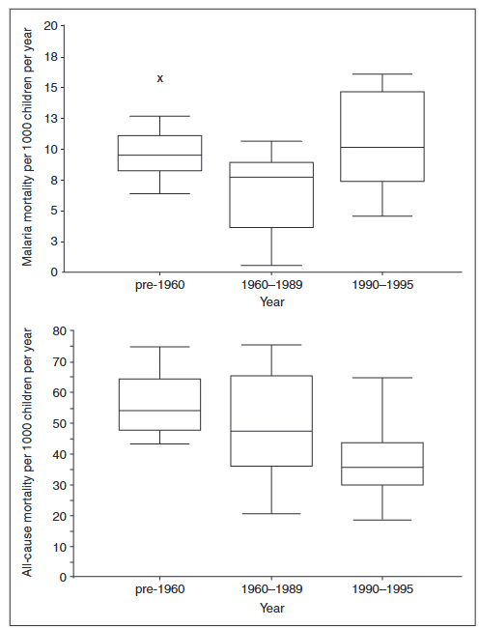
Mosquito-borne diseases comprise some of the oldest threats to human populations
All-cause mortality per 1000 children per year
Malaria mortality per 1000 children per year

Slide 5
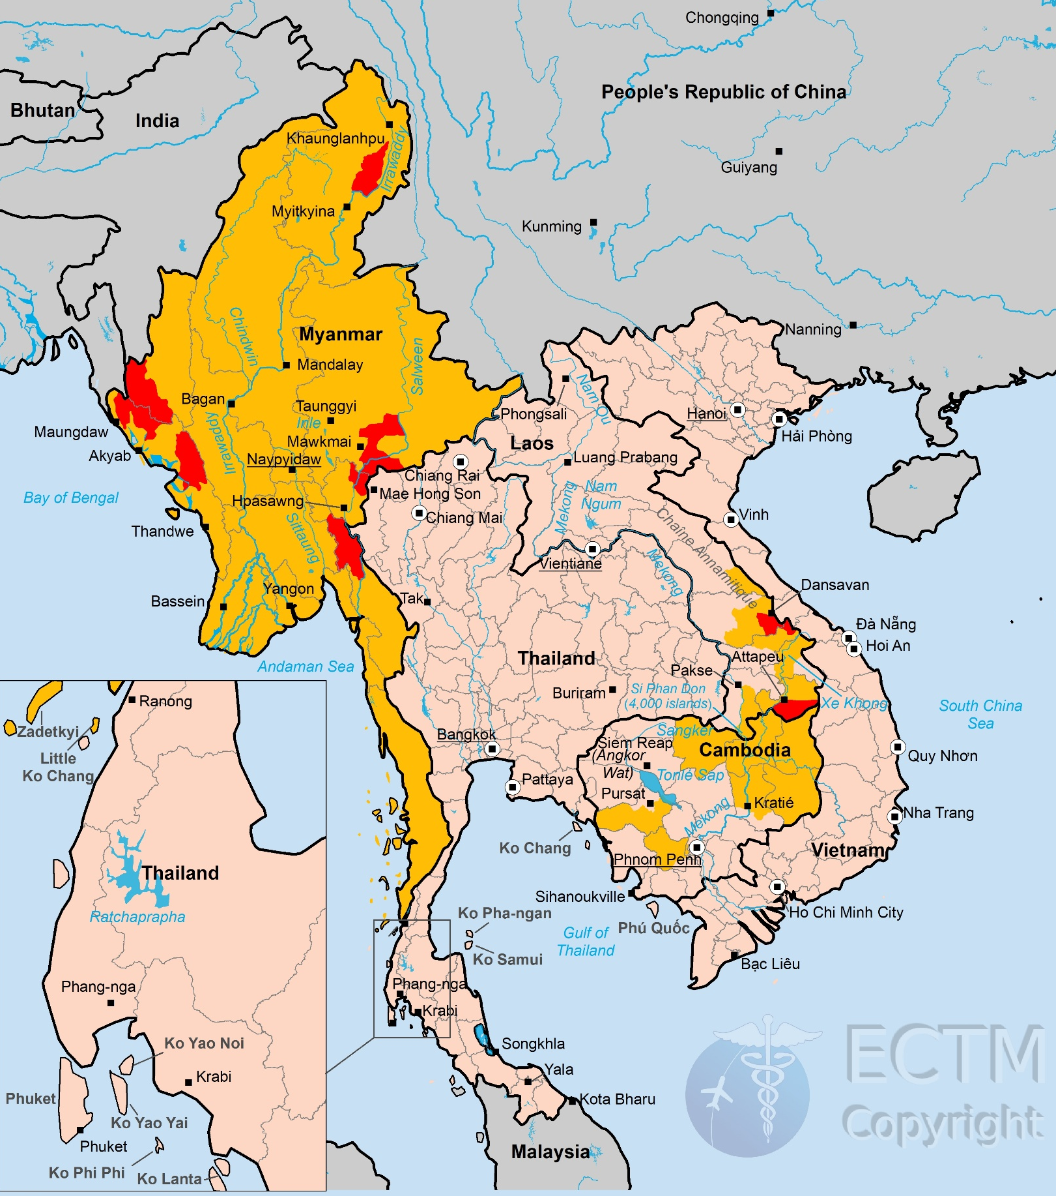
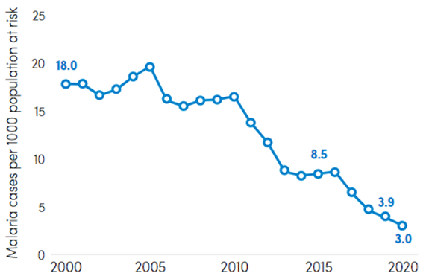
The WHO set a goal of 90% malaria reduction by 2030
South-East Asia region
Notes:
> 200 million cases of malaria and up to 400 million cases of dengue
>25% recent emerging infectious disease outbreaks due to MBDs (Jones 2008, Gould 2017)
Malaria has seen a recent uptick in some regions (World Malaria Report 2021)
Predicting MBD outbreaks is complex, needing to account for:
ecology of multiple hosts,
life history of the insect vectors, and
the traits of the pathogens themselves
environmental variables
coinfection
movement
immunology

Slide 6
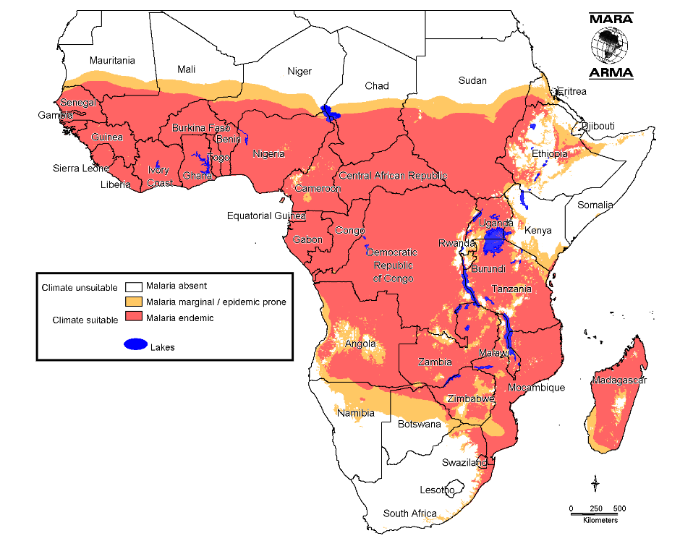
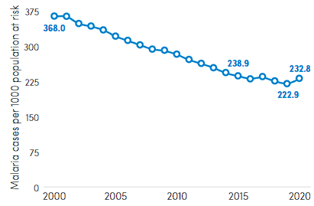
…but progress has stalled
Africa region
Notes:
> 200 million cases of malaria and up to 400 million cases of dengue
>25% recent emerging infectious disease outbreaks due to MBDs (Jones 2008, Gould 2017)
Malaria has seen a recent uptick in some regions (World Malaria Report 2021)
Predicting MBD outbreaks is complex, needing to account for:
ecology of multiple hosts,
life history of the insect vectors, and
the traits of the pathogens themselves
environmental variables
coinfection
movement
immunology

Slide 7
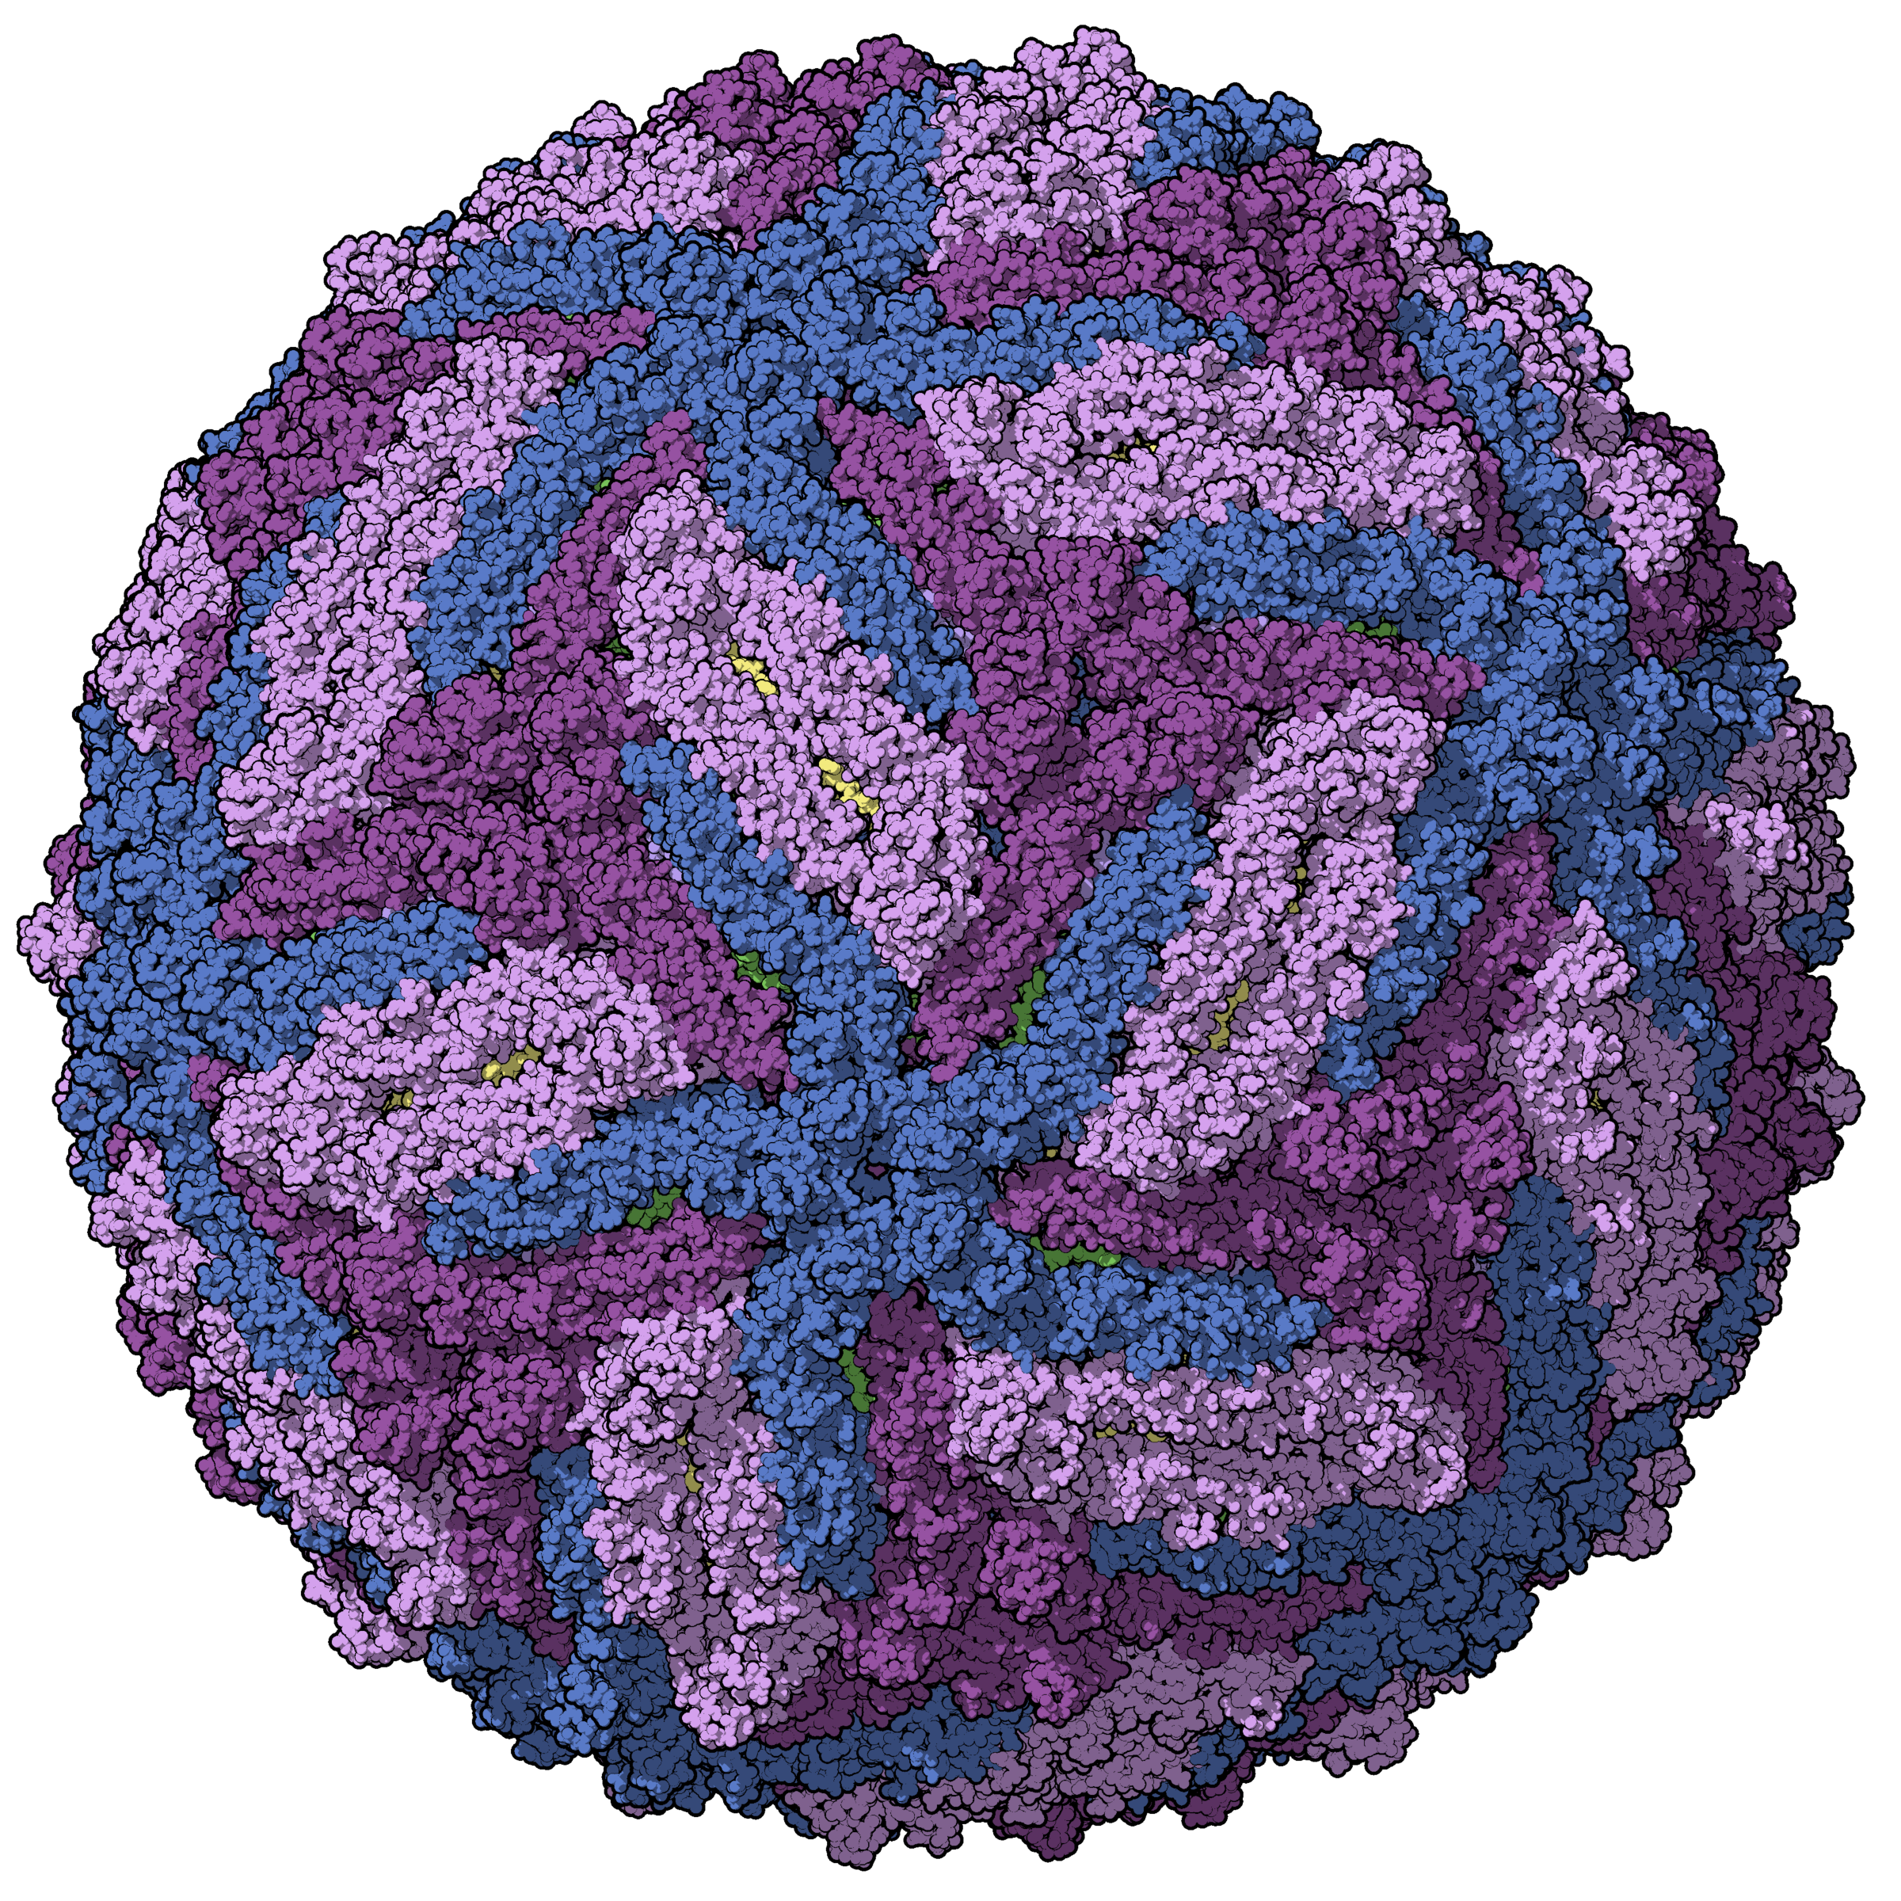
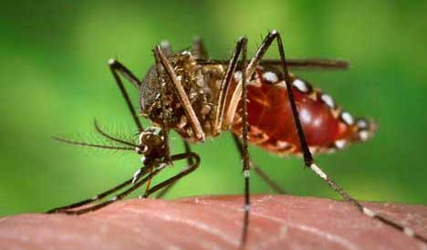
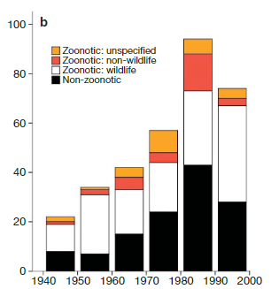
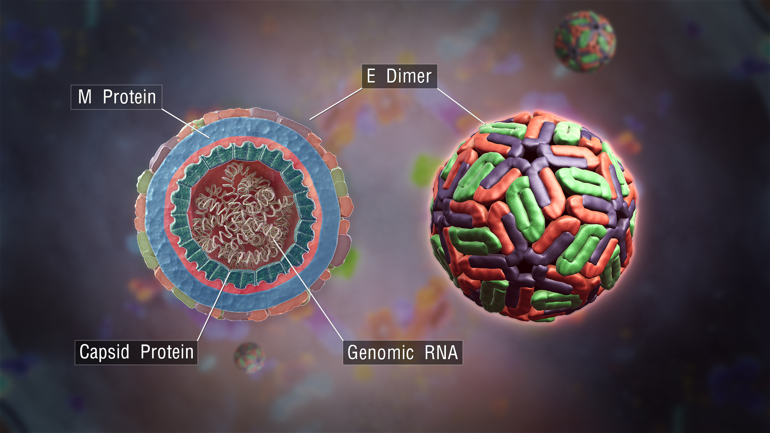
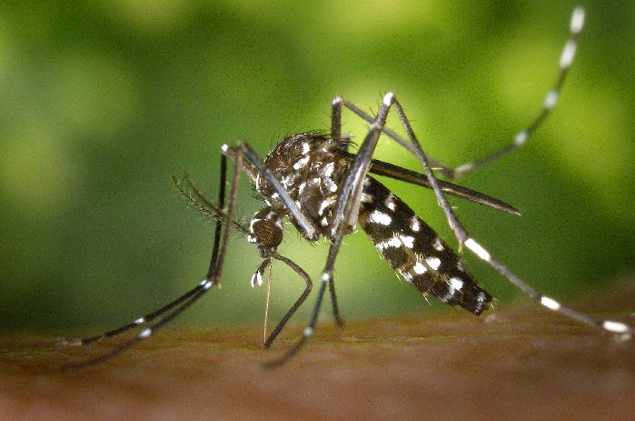
Mosquito-borne diseases also comprise some of the newest threats to human populations
Over 25% of recent emerging infectious disease outbreaks were due to mosquito-borne zoonotic pathogens
Aedes aegypti (CDC.gov)
Zika virus virion
(Manuel Almagro Rivas)
Aedes albopictus (CDC.gov)
Dengue virus virion (ScientificAnimations.com)
Jones, K., Patel, N., Levy, M. et al. Global trends in emerging infectious diseases. Nature 451, 990–993 (2008).
Notes:
Emerging infectious diseases

Slide 8
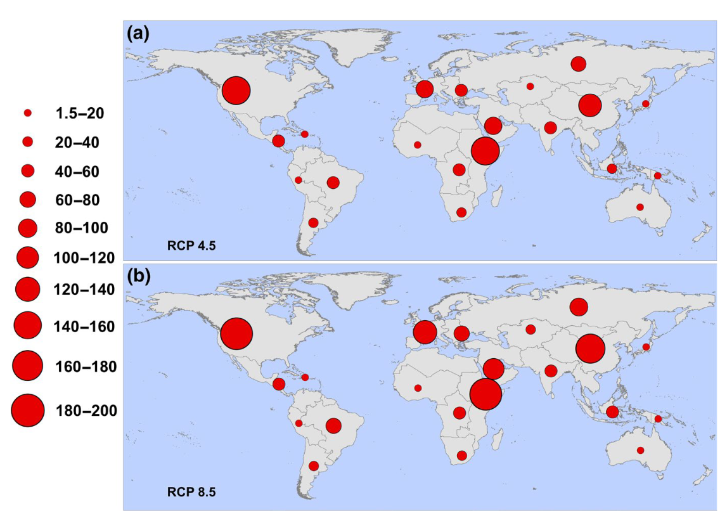
The risk of mosquito-borne disease outbreaks will substantially increase due to global climate change
Regional increases in the population at risk (in millions) for transmission of Zika by 2050
Ryan, S., et al. 2021. Warming Temperatures Could Expose More than 1.3 Billion New People to Zika Virus Risk by 2050. Global Change Biology 27 (1): 84–93.
Notes:
Emerging infectious diseases

Slide 9
Eliminating mosquito-borne diseases is a difficult task but one we should and must confront
Past solutions won’t work for current and future problems – especially in the face of changes to global climate, land use, and movement patterns
We need “all hands on deck” – new ideas and methods from a variety of people, disciplines, and communities

Slide 10
Modelling the biting process
How does biting transmit disease?
Why do mosquitoes bite in the first place?
What is the biting process like?

Slide 11
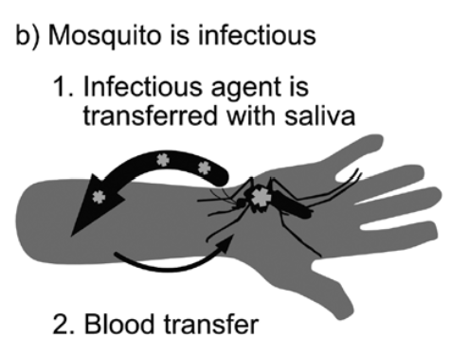
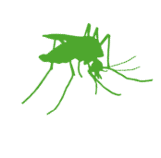

Contact
Infection
Figure credit: Thongsripong, P., et al. 2021. “Human-Mosquito Contact: A Missing Link in Our Understanding of Mosquito-Borne Disease Transmission Dynamics.” Annals of the Entomological Society of America 114 (4): 397–414.

Slide 12
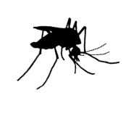
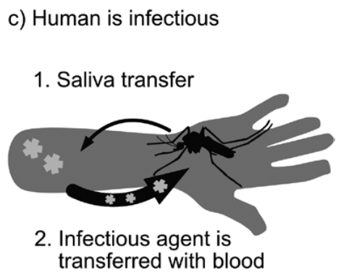
Contact
Infection
Figure credit: Thongsripong, P., et al. 2021. “Human-Mosquito Contact: A Missing Link in Our Understanding of Mosquito-Borne Disease Transmission Dynamics.” Annals of the Entomological Society of America 114 (4): 397–414.

Slide 13

Recovery
Contact
Infection
Infection
Loss of immunity

Slide 14
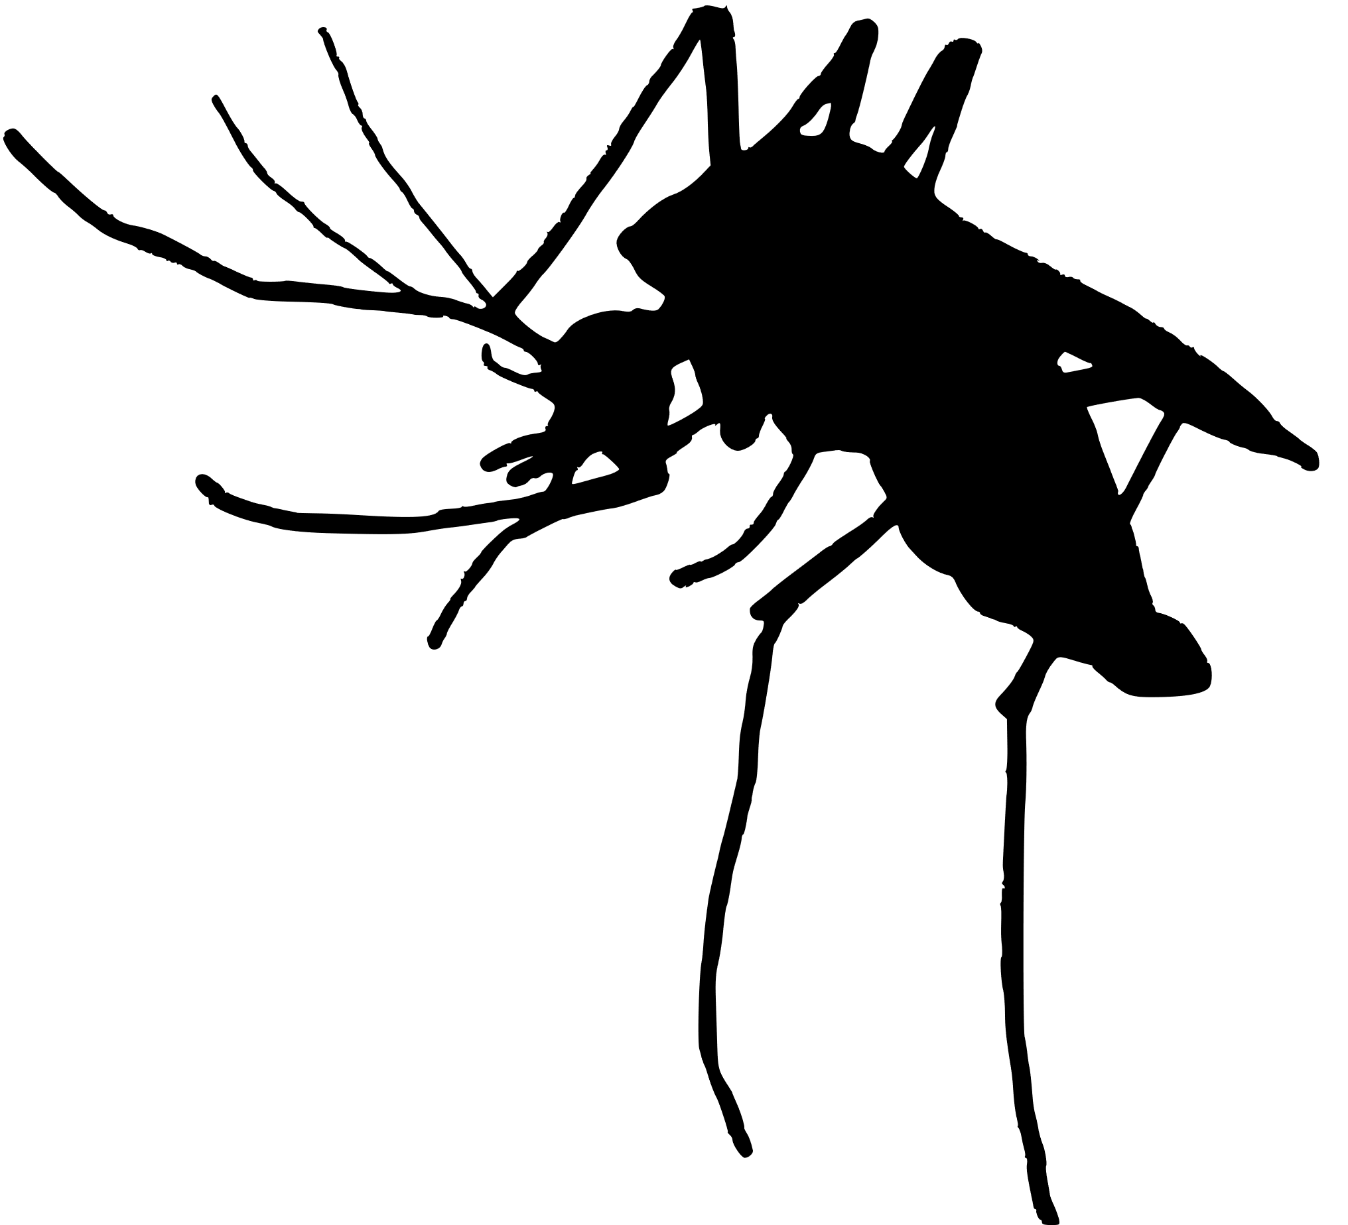
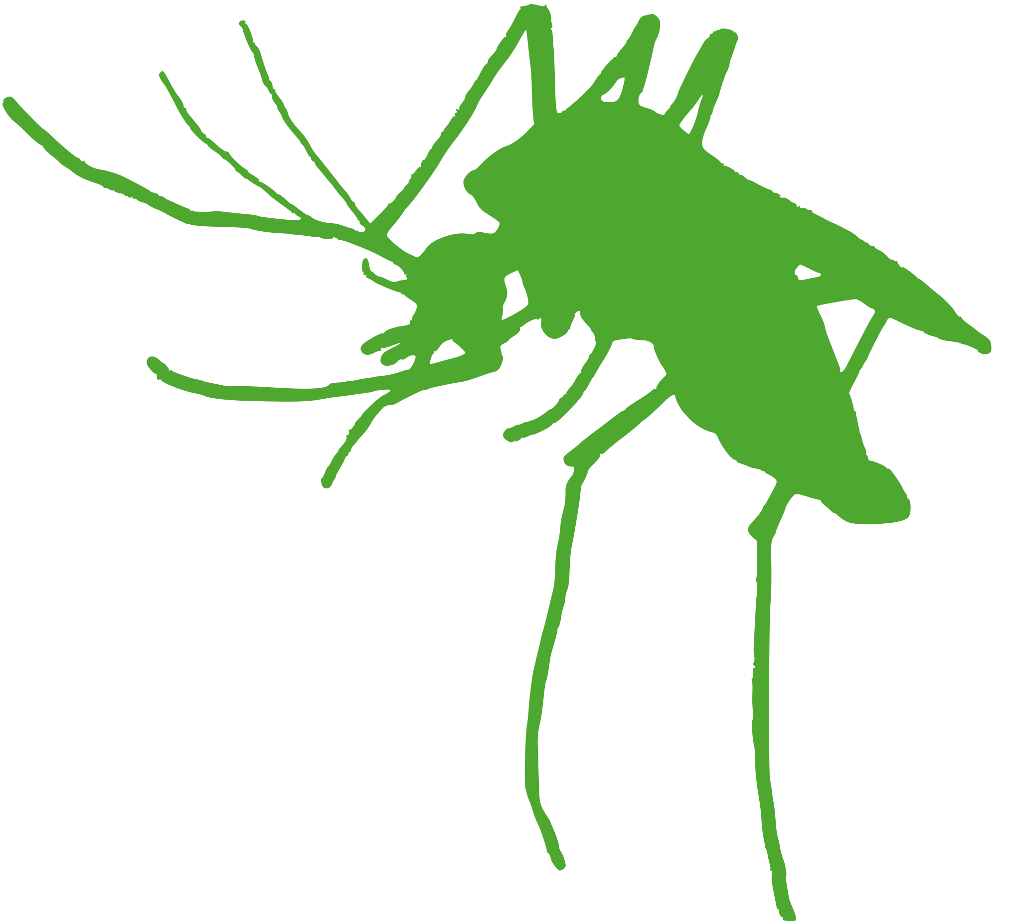
Recovery
Contact
Infection
Loss of immunity

Slide 15

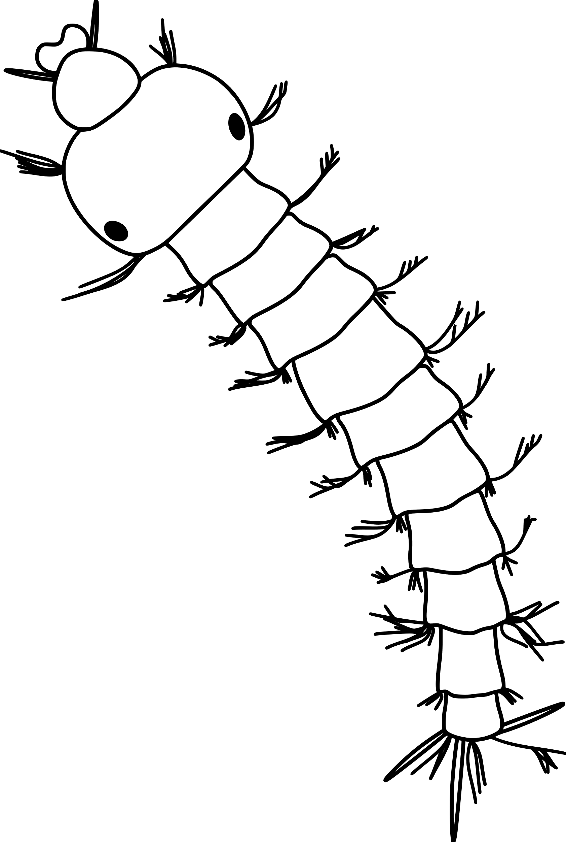
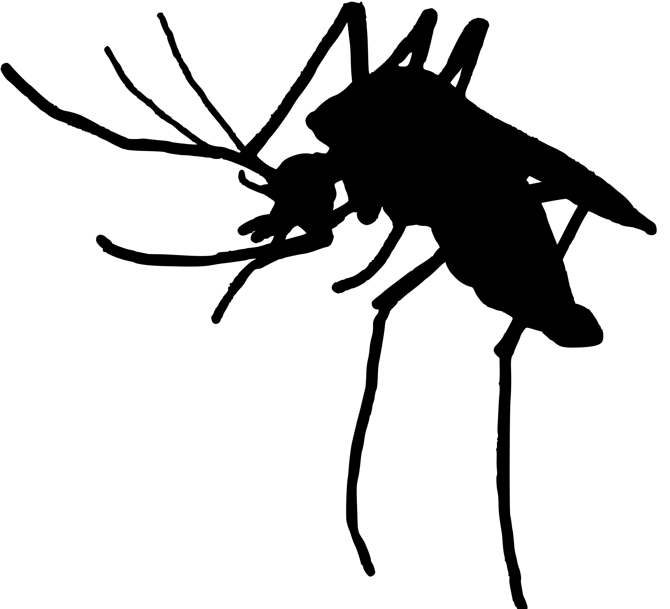
Mosquito Life Cycle
Pupae
Larvae
Biting
Gonotrophic cycle
Ovipositing (egg-laying)
Resting &
Feeding

Slide 16
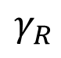
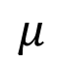
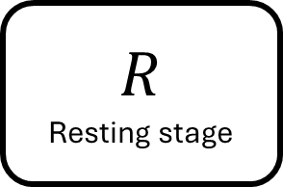
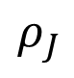
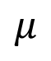
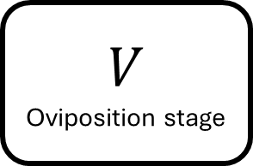
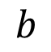
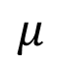
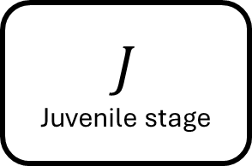
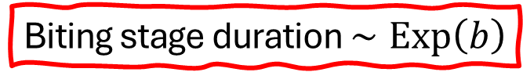
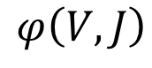
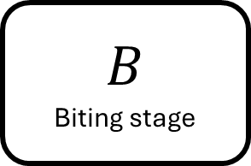
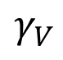
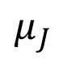
$$μ$$
$$μ$$
$$R$$
Resting stage
$$γ_{V}$$
$$V$$
Oviposition stage
$$γ_{R}$$
Gonotrophic cycle
$$φ\left(V,J\right)$$
$$J$$
Juvenile stage
$$ρ_{J}$$
$$B$$
Biting stage
$$b$$
$$μ_{J}$$
$$μ$$
Biting stage duration $∼\text{Exp}\left(b\right)$

Slide 17
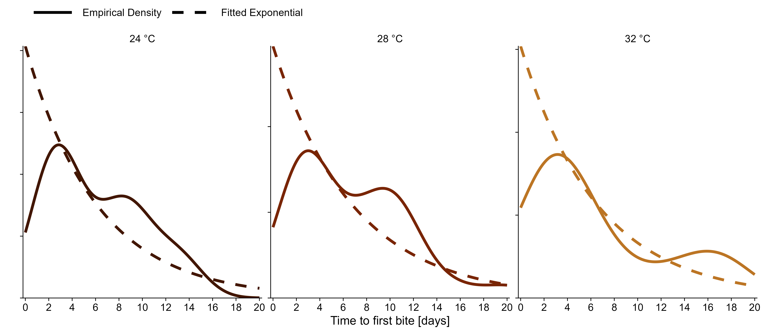
Empirical estimates do not support the exponential distribution assumption
Created with data from: Christofferson, R., et al.. 2022. How Do I Bite Thee? Let Me Count the Ways: Exploring the Implications of Individual Biting Habits of Aedes Aegypti for Dengue Transmission. PLoS Neglected Tropical Diseases 16 (10): e0010818.
Notes:
Greatly over-predicts the proportion of mosquitoes that bite early on

Slide 18
Warning: Images of blood
Choumet et al. (2012). Visualizing non infectious and infectious Anopheles gambiae blood feedings in naive and saliva-immunized mice. PloS One, 7(12), e50464. https://doi.org/10.1371/journal.pone.0050464
Notes:
Talk through the animation. Explain the two processes shown, probing and ingesting, and connect them to transmission
Mention at the end the previous two processes: questing and landing.

Slide 19
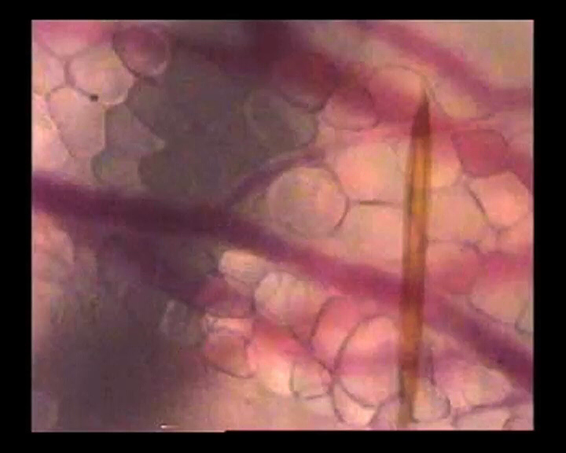
Choumet et al. (2012). Visualizing non infectious and infectious Anopheles gambiae blood feedings in naive and saliva-immunized mice. PloS One, 7(12), e50464. https://doi.org/10.1371/journal.pone.0050464
Notes:
Talk through the animation. Explain the two processes shown, probing and ingesting, and connect them to transmission
Mention at the end the previous two processes: questing and landing.

Slide 20

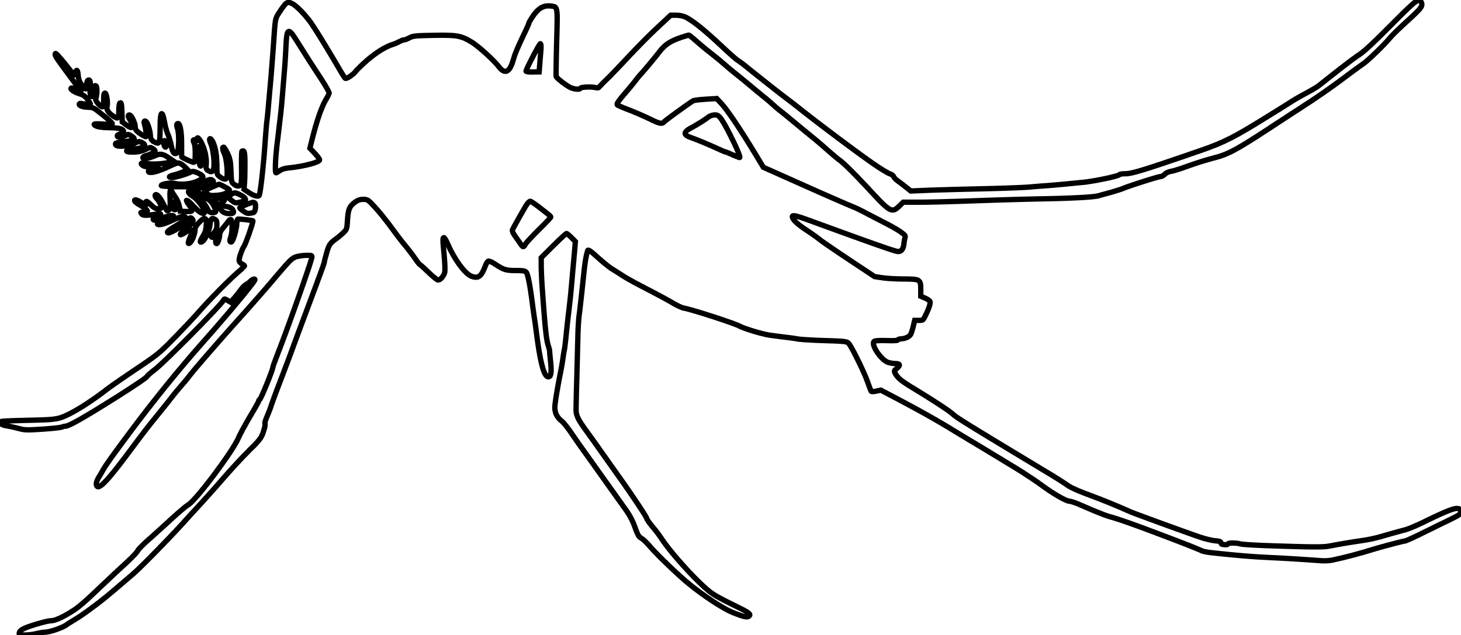
The idealized blood-feeding process
“Successful hematophagy culminates in an intricate cascade of events.” – John D. Edman and Andrew Spielman in Blood-Feeding by Vectors: Physiology, Ecology, Behavior, and Vertebrate Defense
Seeking and finding host
Landing
Probing
Ingesting
Repletion:
Proceed to oviposition stage

Slide 21
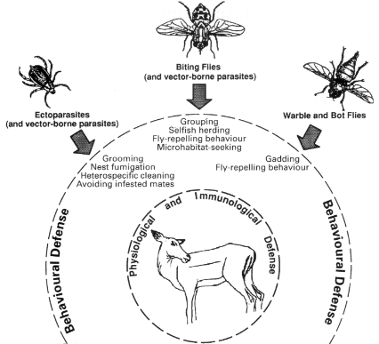
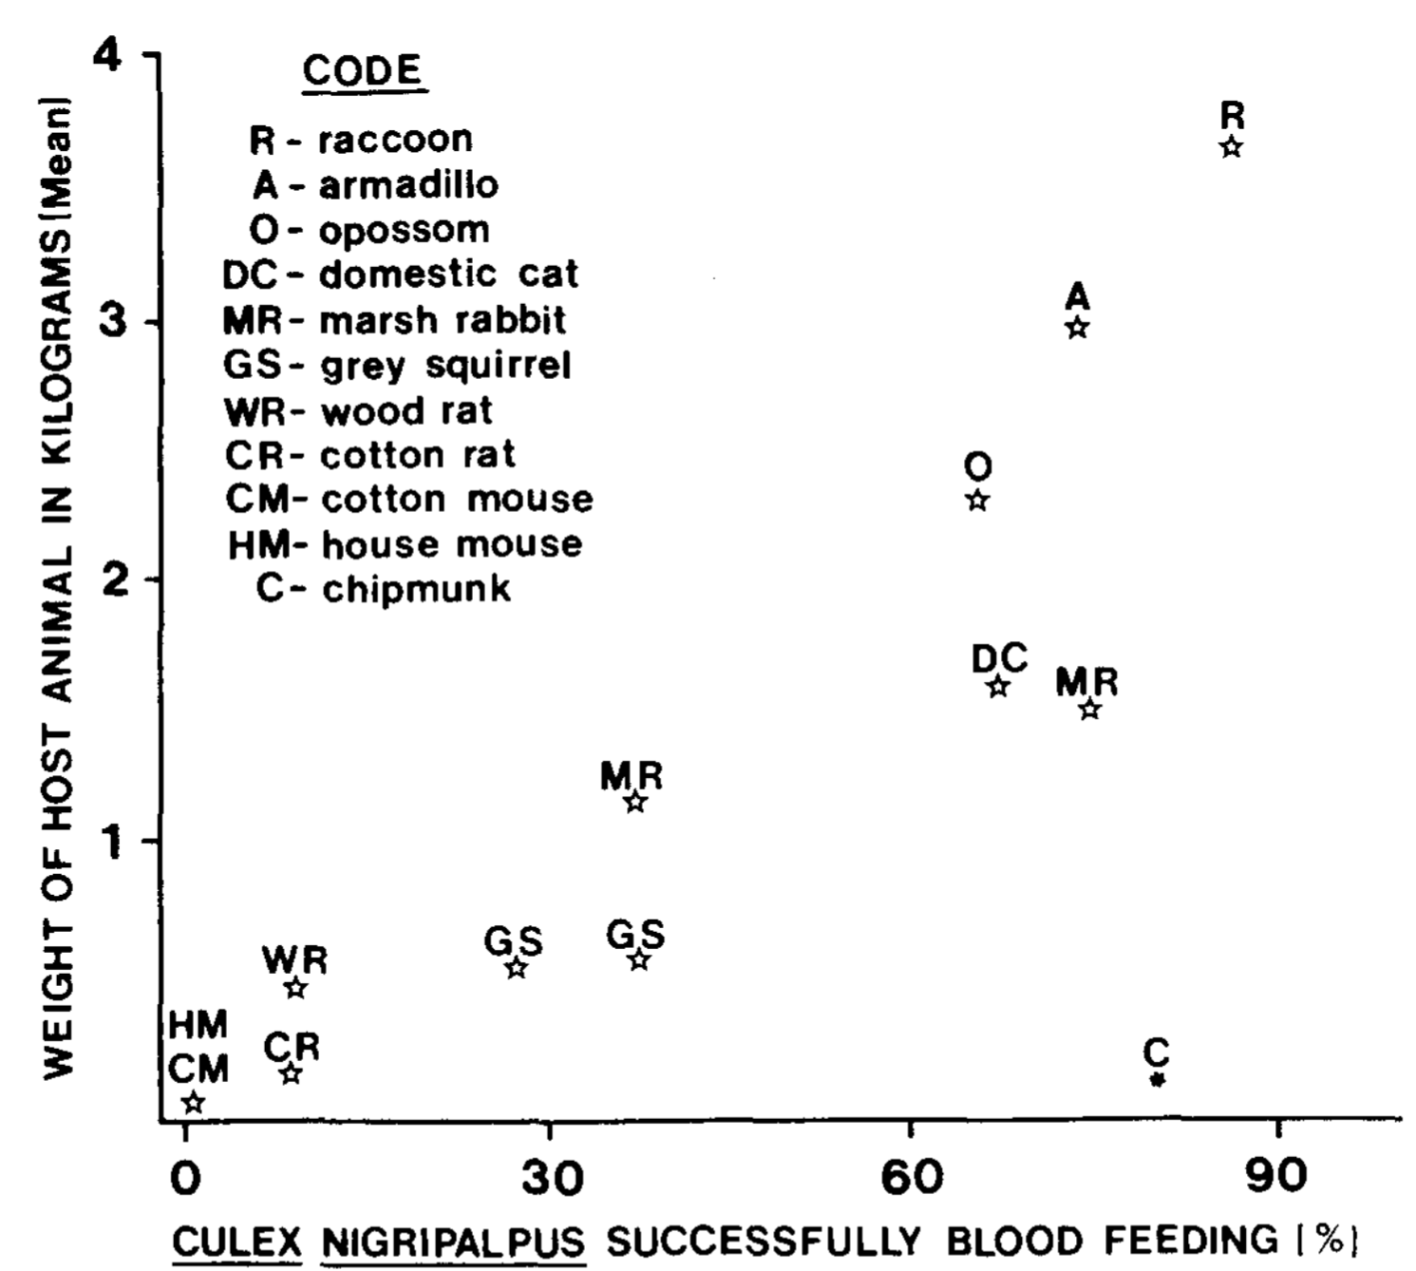
What could go wrong during blood-feeding?
Hosts have an array of defensive strategies they can employ to avoid insect blood feeding
Hart (1994) Parasitology
The effectiveness of defensive behaviors against mosquitoes varies greatly across species and is linked to body size
Edman & Scott (1987) International Journal of Tropical Insect Science

Slide 22
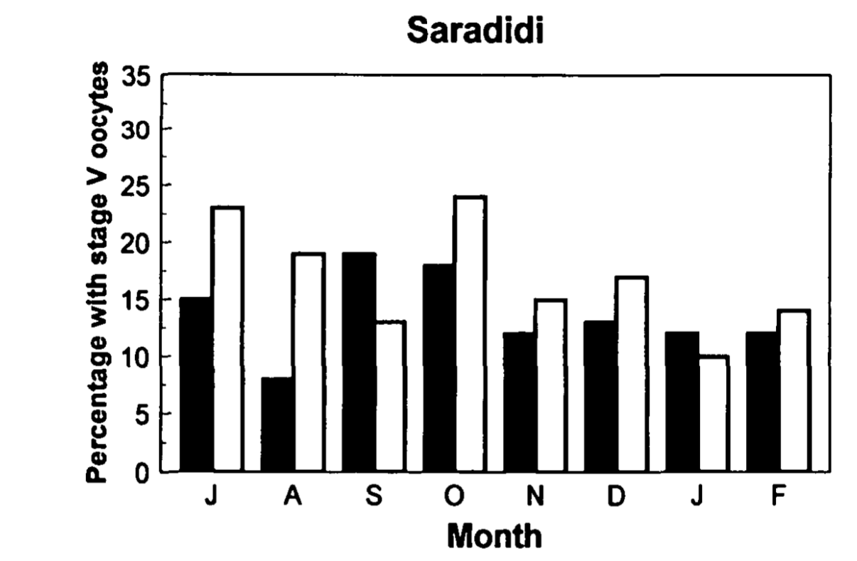
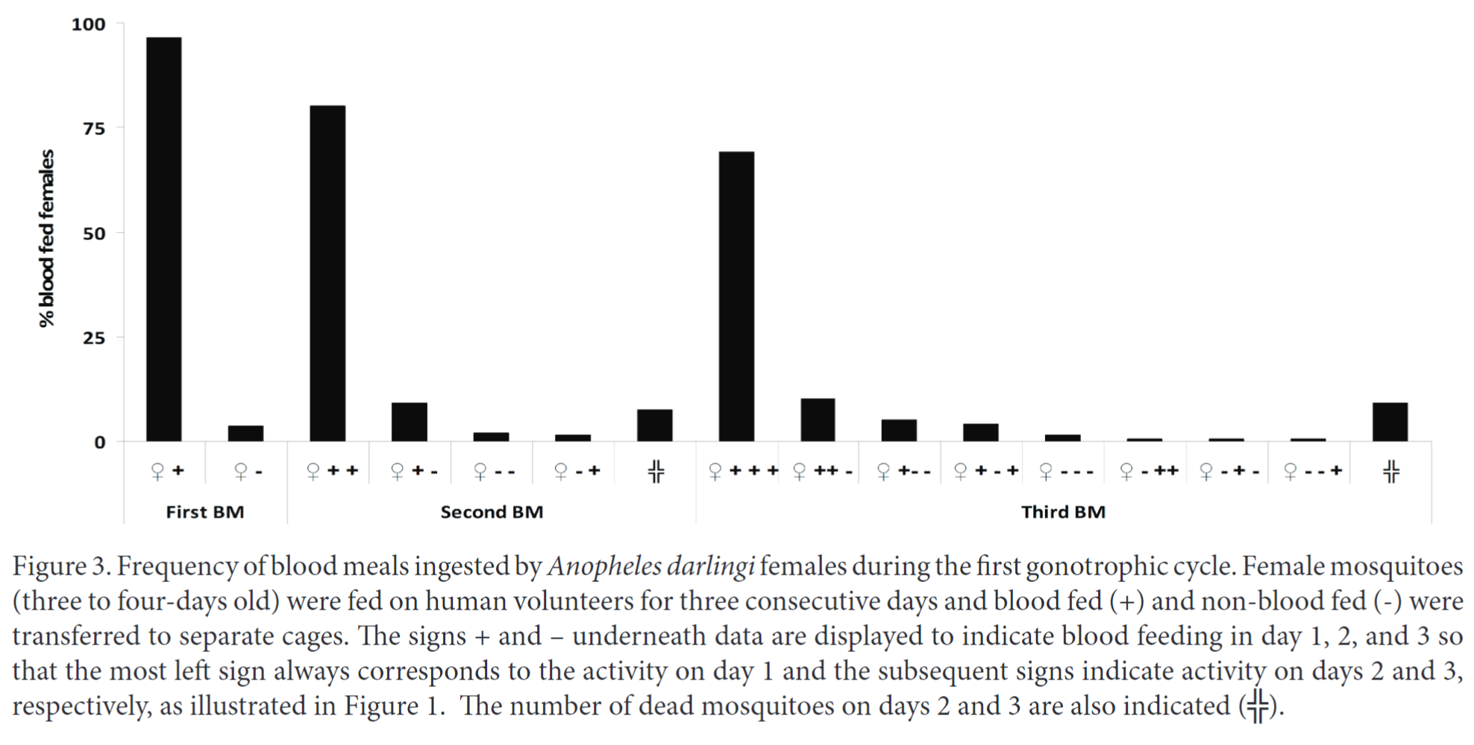
Multiple biting – attempting to feed more than once in a reproductive cycle – is common among mosquitoes
1
2
3
1
2
0
0
1
1
2
0
2
1
1
Proportion of Anopheles gambiae and An. Funestus mosquitoes taking an additional blood meal
Modified from Beier (1996) J Med Entomol
Frequency of blood meals ingested by Anopheles darlingi females in a single gonotrophic cycle. Numbers above bars indicate total number of blood meals.
Modified from de Oliveira et al. (2012) J Vector Ecol
Notes:
NB: We use the term “multiple blood feeding” generically to include both interrupted and mixed blood feeding
Particularly true for Anopheles mosquitoes: the primary culprits in transmission of malaria parasites

Slide 23
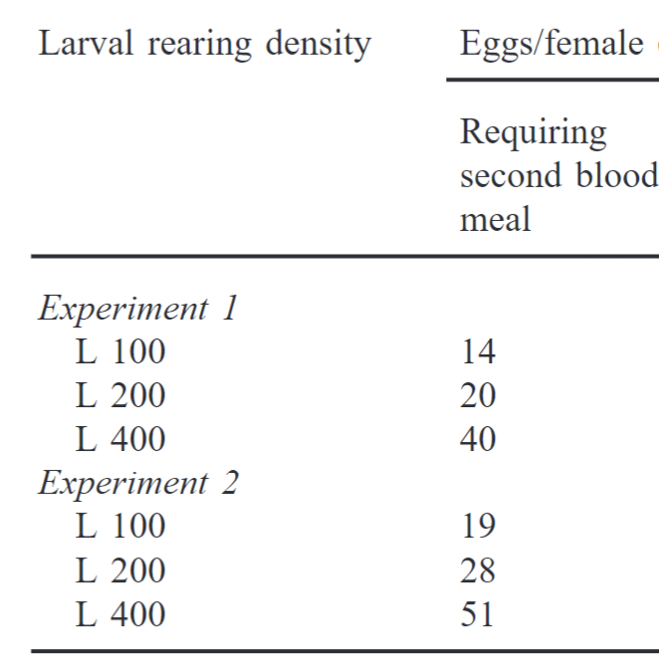
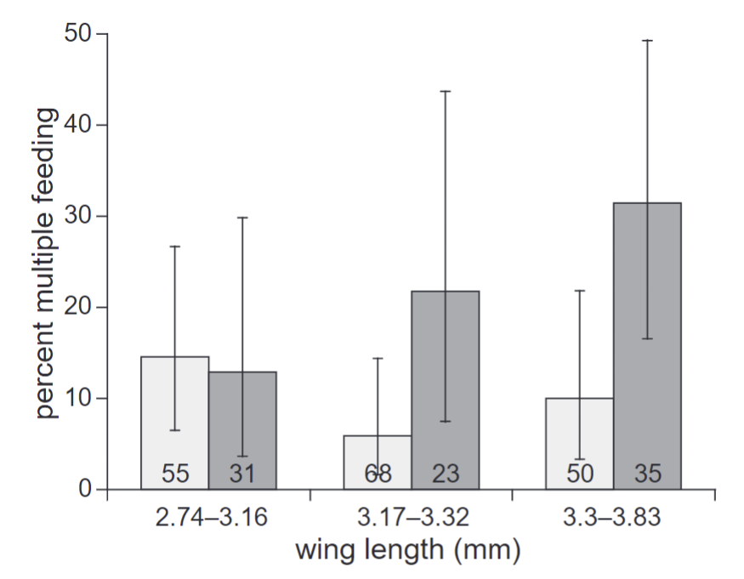
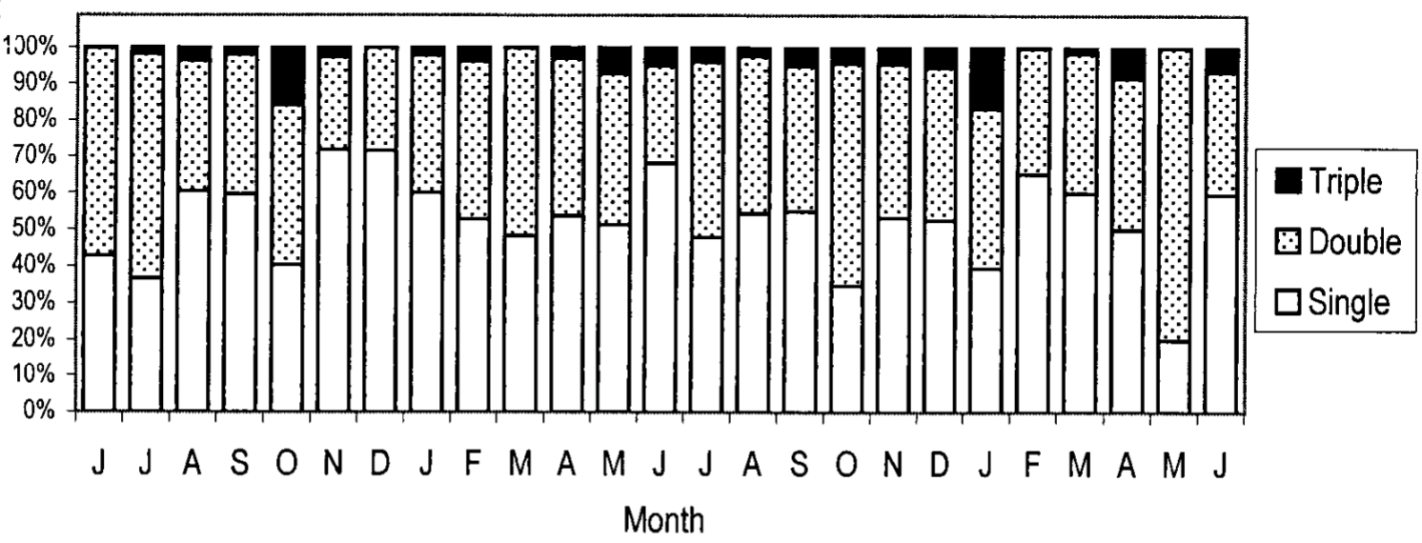
Drivers of multiple biting
Population density
Infection status or body size
Uninfected with malaria
Infected with malaria
Ramasamy et al. (2000) J Insect Physiol
Seasonality
Effect of size and infection status (Plasmodium falciparum) on the probability of Anopheles gambiae having multiple blood meals
Modified from Koella, et al (1998) Proc Biol Sci
Seasonality drives patterns in multiple blood feeding for Aedes aegypti
Modified from Scott et al. (2000) J Med Entomol

Slide 24
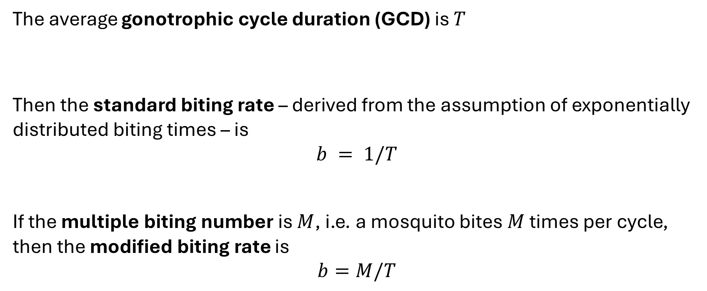
How is multiple biting usually modeled?
The average gonotrophic cycle duration (GCD) is $T$
Then the standard biting rate – derived from the assumption of exponentially distributed biting times – is
$$b = 1/T$$
If the multiple biting number is $M$, i.e. a mosquito bites $M$ times per cycle, then the modified biting rate is
$$b=M/T$$

Slide 25
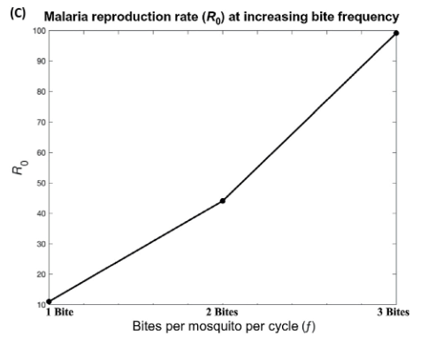
Multiple biting could multiply transmission
More frequent feeding attempts
3x increase in biting frequency
→ 10x increase in transmission
More frequent contact with hosts
More opportunities for disease transmission
Tedrow, R. E., P. A. Zimmerman, and K. C. Abbott. 2019. Multiple Blood Feeding: A Force Multiplier for Transmission. Trends in parasitology 35:949–952.

Slide 26
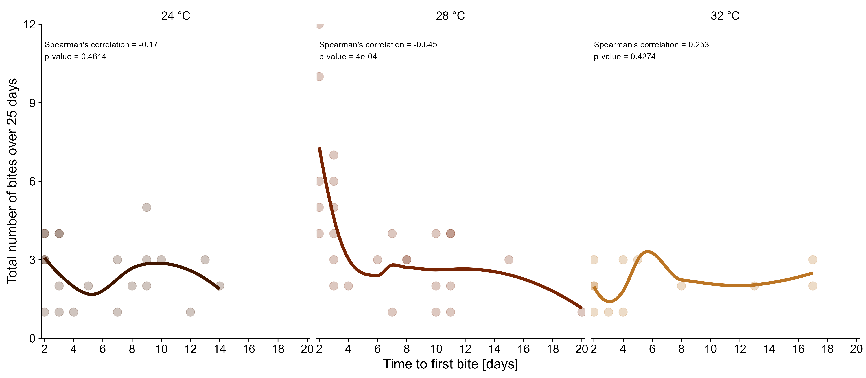
Biting rate and biting number may be correlated
Created with data from: Christofferson, R., et al.. 2022. How Do I Bite Thee? Let Me Count the Ways: Exploring the Implications of Individual Biting Habits of Aedes Aegypti for Dengue Transmission. PLoS Neglected Tropical Diseases 16 (10): e0010818.

Slide 27
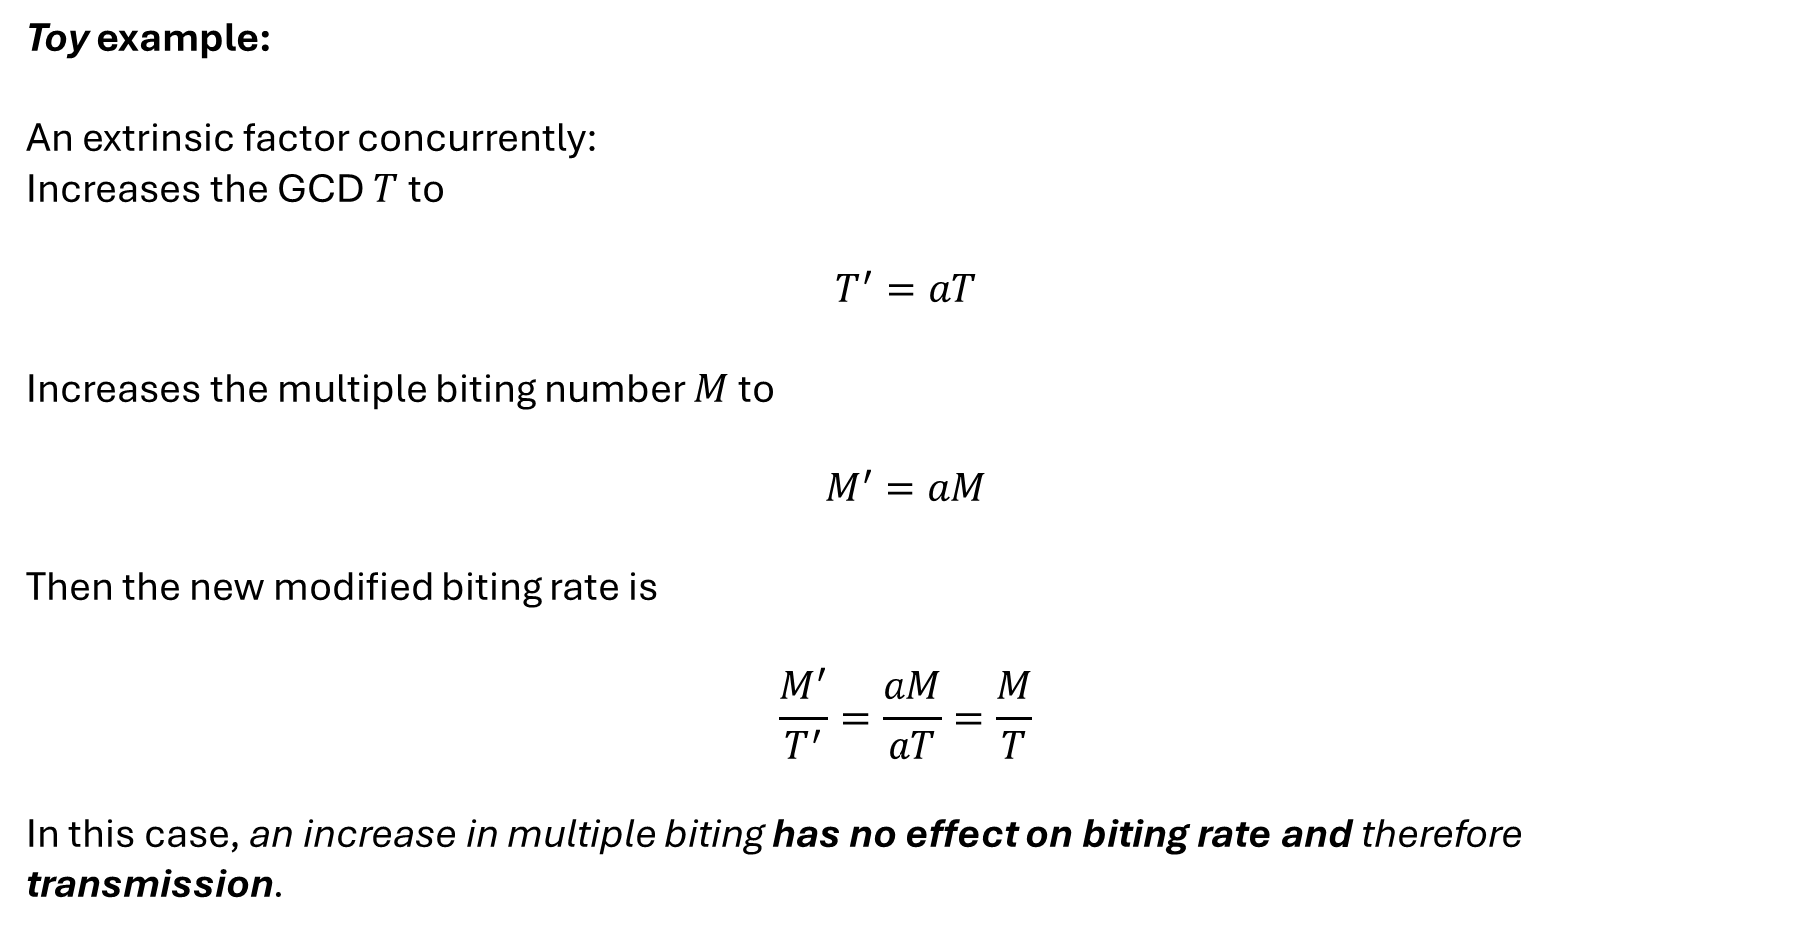
What if the GCD and multiple biting number are correlated?
Toy example:
An extrinsic factor concurrently:
Increases the GCD $T$ to
$$T^{′}=aT$$
Increases the multiple biting number $M$ to
$$M^{′}=aM$$
Then the new modified biting rate is
$$\frac{M^{′}}{T^{′}}=\frac{aM}{aT}=\frac{M}{T}$$
In this case, an increase in multiple biting has no effect on biting rate and therefore transmission.

Slide 28
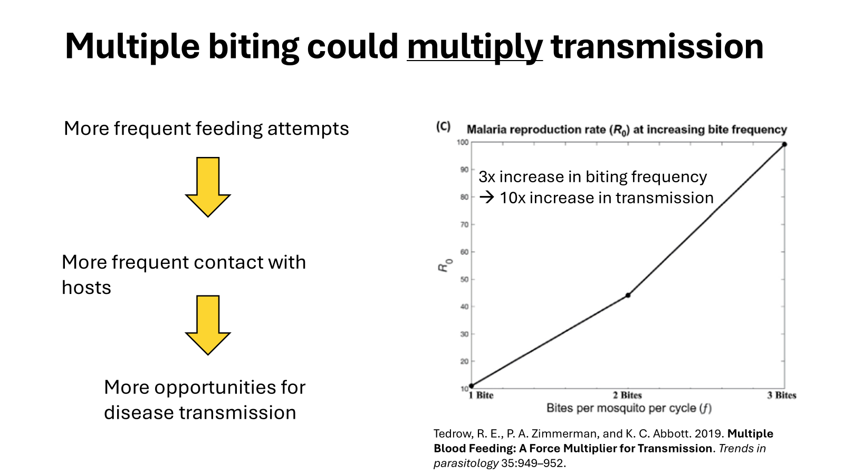
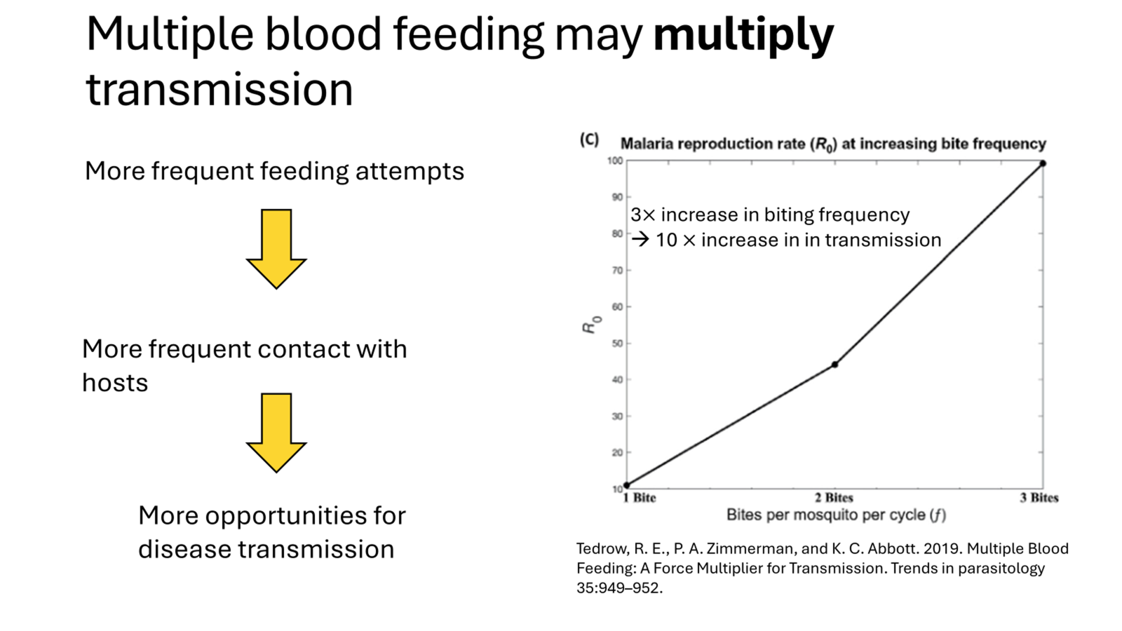
How do specific mechanisms or drivers affect the interaction between multiple biting and transmission?
To explore this and other questions, we need to generalize how the biting process is modeled

Slide 29
A vicious cycle between modelers and empiricists
Modelers don’t include the biting process in models
Assumption:
“Empiricists don’t think the biting process is important.”
– or –
“Empiricists have no way of measuring the process.”
Assumption:
“Models don’t show that the biting process is important.”
Empiricists don’t measure biting process

Slide 30


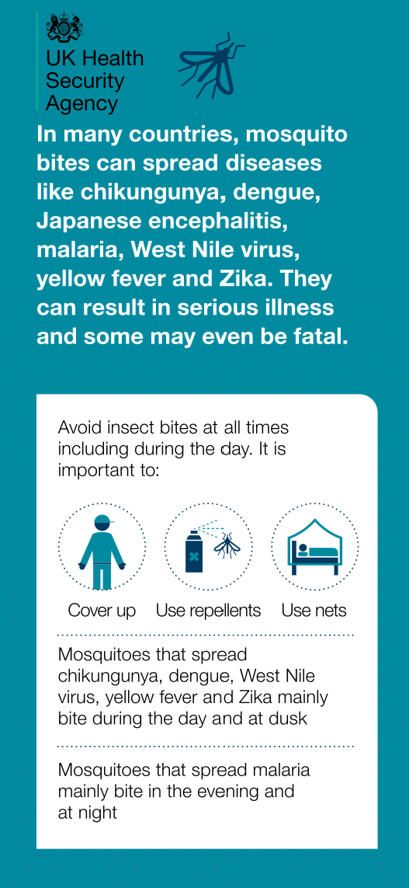


Slide 31



Personal protection measures are commonly recommended for mosquito-borne disease prevention

Slide 32

Commonly-recommended personal protective measures
are not included in mosquito-borne disease models.
How might they affect predictions of long term disease spread?

Slide 33
A generalized modeling framework for the mosquito biting process
An introduction to phase-type distributed Markov process and the Generalized Linear Chain Trick
Integrating transmission
Some examples

Slide 34


Phase-type distributions generalize the exponential distribution
Parameterized by an initial vector $\vec{α}$ and transient rate matrix $A$
$\text{PH}\left(\vec{α}, A\right)$

Slide 35





$\text{Exp}\left(a\right)\text{=}\text{PH}\left(1, −a\right)$
Phase-type distributions generalize the exponential distribution
Transient state
Input rate =
$$r$$
$$X$$
$$a$$
= Exit rate
Time spent in compartment $X$ is distributed exponentially with rate parameter $a$
The average duration spent in the states $X_{1}$ through $X_{n}$ is $\frac{1}{a}$

Slide 36





$\text{Erlang}\left(na,n\right)\text{=}\text{PH}\left(\vec{α}, A\right)$
Phase-type distributions include many familiar distributions
$$\left[\begin{aligned}1 \\ 0 \\ ⋮ \\ 0\end{aligned}\right]$$
$$−na$$ | $$na$$ | $$⋯$$ | $$0$$
$$0$$ | $$−na$$ | $$⋱$$ | $$⋮$$
$$⋮$$ | $$⋱$$ | $$⋱$$ | $$na$$
$$0$$ | $$⋯$$ | $$0$$ | $$−na$$
$$\vec{α}=$$
$$A=$$

Slide 37







$\text{Erlang}\left(na,n\right)\text{=}\text{PH}\left(\vec{α}, A\right)$
Phase-type distributions include many familiar distributions
$$\left[\begin{aligned}1 \\ 0 \\ ⋮ \\ 0\end{aligned}\right]$$
$$−na$$ | $$na$$ | $$⋯$$ | $$0$$
$$0$$ | $$−na$$ | $$⋱$$ | $$⋮$$
$$⋮$$ | $$⋱$$ | $$⋱$$ | $$na$$
$$0$$ | $$⋯$$ | $$0$$ | $$−na$$
$$\vec{α}=$$
$$A=$$
Transient state
Transient state
Transient state
Input rate =
$$na$$
$$r$$
$$X_{1}$$
$$X_{2}$$
$$na$$
$$X_{n}$$
$$na$$
= Exit rate
Time spent in compartment $X$ is Erlang-distributed with rate parameter $na$ and shape parameter $n$.
The average duration spent in the states $X_{1}$ through $X_{n}$ is $\frac{1}{a}$

Slide 38




Phase-type distributions represent “general” Markov processes
$$X_{1}$$
$$X_{2}$$
Transient states
$$⋮$$
$$X_{i}$$
$$⋮$$
$$X_{n}$$

Slide 39









Phase-type distributions represent general Markov processes
$$rα_{1}$$
$$X_{1}$$
$r=$ Total input rate
The initial vector $\vec{α}$ determines
the proportion entering $X_{i}$, $α_{i}$, with$∑α_{i}=1$
$$rα_{2}$$
$$X_{2}$$
$$⋮$$
$$rα_{i}$$
$$X_{i}$$
$$⋮$$
$$rα_{n}$$
$$X_{n}$$

Slide 40








Phase-type distributions represent general Markov processes
$$X_{1}$$
$$a_{12}$$
$$X_{2}$$
The transient rate matrix $A=\left[a_{ij}\right]$ specifies the transition rates from $X_{i}$ to $X_{j}$ when $i≠j$.
$$a_{n1}$$
$$⋮$$
$$a_{i2}$$
$$X_{i}$$
$$⋮$$
$$X_{n}$$

Slide 41






$$X_{1}$$
The $i^{th}$row sum of $A$ gives the exit rate from $X_{i}$ out of the transient states into absorbing state(s)
$$X_{2}$$
$$−A\vec{1}$$
$$⋮$$
$$X_{i}$$
$$⋮$$
$$X_{n}$$

Slide 42









Phase-type distributions: $\text{PH}\left(\vec{α}, A\right)$
$$rα_{1}$$
$$X_{1}$$
The $i^{th}$row sum of $A$ give the exit rate from $X_{i}$ out of the transient states
$α_{i}=$ proportion entering $X_{i}$
$∑α_{i}=1$
$$rα_{2}$$
$$X_{2}$$
$A=\left[a_{ij}\right]$
$a_{ij}=$ transition rate from $X_{i}$ to $X_{j}$
$$−A\vec{1}$$
$$⋮$$
$$rα_{i}$$
$$X_{i}$$
$$⋮$$
$$rα_{n}$$
$$X_{n}$$
Time spent in compartments $\vec{X}$ is distributed with phase type distribution $\text{PH}\left(\vec{α}, A\right)$

Slide 43









$\text{Erlang}\left(na,n\right)\text{=}\text{PH}\left(\vec{α}, A\right)$
The linear chain trick
Transient state
Transient state
Transient state
Input rate =
$$na$$
$$r$$
$$X_{1}$$
$$X_{2}$$
$$na$$
$$X_{n}$$
$$na$$
= Exit rate
The mean-field approximation of this process is represented by the system of ODEs:
$$\frac{d}{dt}X_{1}=r−naX_{1}, \\ \frac{d}{dt}X_{2}=naX_{1}−naX_{2}, \\ \frac{d}{dt}X_{i}=naX_{i−1}−naX_{i}, \\ \frac{d}{dt}X_{n}=naX_{n−1}−naX_{n}$$

Slide 44








$\text{Erlang}\left(na,n\right)\text{=}\text{PH}\left(\vec{α}, A\right)$
The linear chain trick
Transient state
Transient state
Transient state
Input rate =
$$na$$
$$r$$
$$X_{1}$$
$$X_{2}$$
$$na$$
$$X_{n}$$
$$na$$
= Exit rate
The mean-field approximation of this process is represented by the system of ODEs:
$$\frac{d}{dt}\left[\begin{aligned}X_{1} \\ X_{2} \\ ⋮ \\ X_{n}\end{aligned}\right]=r\left[\begin{aligned}1 \\ 0 \\ ⋮ \\ 0\end{aligned}\right]−\left[\begin{matrix}na & 0 & ⋯ & 0 \\ −na & na & ⋱ & 0 \\ ⋮ & ⋱ & ⋱ & ⋮ \\ 0 & ⋯ & na & −na\end{matrix}\right]\left[\begin{aligned}X_{1} \\ X_{2} \\ ⋮ \\ X_{n}\end{aligned}\right]$$

Slide 45

$\text{Erlang}\left(na,n\right)\text{=}\text{PH}\left(\vec{α}, A\right)$
The linear chain trick
Transient state
Transient state
Transient state
Input rate =
$$na$$
$$r$$
$$X_{1}$$
$$X_{2}$$
$$na$$
$$X_{n}$$
$$na$$
= Exit rate
The mean-field approximation of this process is represented by the system of ODEs:
$$\frac{d}{dt}\vec{X}=r\vec{α}−A^{T}\vec{X}$$

Slide 46


The generalized linear chain trick Hurtado & Kirosingh (2019)
Given a set of transient states $\vec{X}$ with total input rate $r$ whose dwell-time distribution is $\text{PH}\left(\vec{α}, A\right)$, where all rates are autonomous, its mean field dynamics are described by the system of ODEs:
$$\frac{d}{dt}\vec{X}=r\vec{α}−A^{T}\vec{X}$$
Hurtado, Paul J., and Adam S. Kirosingh. 2019. “Generalizations of the ‘Linear Chain Trick’: Incorporating More Flexible Dwell Time Distributions into Mean Field ODE Models.” Journal of Mathematical Biology 79 (5): 1831–83. https://doi.org/10.1007/s00285-019-01412-w.

Slide 47

Mosquito demographic model with exponential biting rate
$$μ$$
$$μ$$
$$R$$
Resting stage
$$γ_{V}$$
$$V$$
Oviposition stage
$$γ_{R}$$
Gonotrophic cycle
$$φ\left(V,J\right)$$
$$J$$
Juvenile stage
$$ρ_{J}$$
$$B$$
Biting stage
$$b$$
$$μ_{J}$$
$$μ$$
Average biting stage duration:
$$1/b$$

Slide 48










Mosquito demographic model with general phase-type biting rates
$$μ$$
$$μ$$
$$R$$
Resting stage
$$γ_{V}$$
$$V$$
Oviposition stage
Gonotrophic cycle
$$γ_{R}$$
$$φ\left(V,J\right)$$
$$J$$
Juvenile stage
$$ρ_{J}$$
$$\vec{B}$$
Biting stages
$$−{\vec{1}}^{T}A^{T}$$
Average biting stage duration:
$${\vec{α}}^{T}{\left(−A^{T}\right)}^{−1}\vec{1}$$
$$μ_{J}$$
$$μ$$

Slide 49













Mosquito population demographic model Exponential biting rate
$$μ$$
$$μ$$
$$R$$
Resting stage
$$γ_{V}$$
$$V$$
Oviposition stage
$$1−b$$
$$γ_{R}$$
$$φ\left(V,J\right)$$
$$J$$
Juvenile stage
$$ρ_{J}$$
$$B$$
Biting stage
$$b$$
$$μ_{J}$$
$$μ$$

Slide 50



Generalized linear
chain trick (GLCT)
Biting process transient rate matrix
Mean-field ODEs of biting process dynamics
$$A$$
$$A$$
Notes:
Maybe: combine probing, salivation, and feeding then break them out later when focusing on transmission

Slide 51
Generalized linear
chain trick (GLCT)
Biting process transient rate matrix
Mean-field ODEs of biting process dynamics
$$A$$
$$A$$
$$A$$
Notes:
Maybe: combine probing, salivation, and feeding then break them out later when focusing on transmission

Slide 52

Base mosquito demographic model
$\frac{d}{dt}J=φ\left(V,J\right)−ρ_{J}J−μ_{J}J$
$\frac{d}{dt}\vec{B}=\left(ρ_{J}J+γ_{R}R\right)\vec{α}−\left(μI−A^{T}\right)\vec{B}$
$\frac{d}{dt}V={\left(−A\vec{1}\right)}^{T}\vec{B}−γ_{V}V−μV$
$\frac{d}{dt}R=γ_{V}V−γ_{R}R−μR$
Notes:
Maybe: combine probing, salivation, and feeding then break them out later when focusing on transmission

Slide 53
Theorem: Mosquito population persistence
The mosquito population persists if and only if the basic offspring number, , is greater than one.
Total probability of surviving biting stages
Lifetime reproduction
Lifetime number of (gonotrophic) cycles
Notes:
Brief explanation of these quantities in words, not parameters

Slide 54
Need to explain:
Epidemiological compartments
Contact rates
Transmission probabilities
Disease-free equilibrium
R0, stability of the DFE

Slide 55
Mosquito population
Susceptible
Exposed
Infectious
Exposure
Pathogen development

Slide 56
Mosquito population
Susceptible
Exposed
Infectious
Exposure
Pathogen development
Host population
Recovered
Infected
Susceptible

Slide 57

Mosquito population
Susceptible
Exposed
Infectious
Exposure
Pathogen development
Host population
Recovered
Infected
Susceptible

Slide 58
Mosquito population
Susceptible
Exposed
Infectious
Exposure
Pathogen development
Host population
Recovered
Infected
Susceptible

Slide 59
Mosquito population
Susceptible
Exposed
Infectious
Exposure
Pathogen development
Host population
Recovered
Infected
Susceptible

Slide 60
Mosquito population
Susceptible
Exposed
Infectious
Exposure
Pathogen development
Host population
Recovered
Infected
Susceptible

Slide 61
Mosquito population
Susceptible
Exposed
Infectious
Exposure
Pathogen development
Host population
Recovered
Infected
Susceptible

Slide 62
Mosquito population
Susceptible
Exposed
Infectious
Exposure
Pathogen development
Host population
Recovered
Infected
Susceptible

Slide 63










Parasite transmission and development
Mosquito population
Susceptible
$$\frac{d}{dt}{\overset{⃑}{S}}_{B}=\left(ρ_{J}J+γV\right) \overset{⃑}{α}−Φ_{B}{\vec{S}}_{B}−\left(μI−{ }^{T}\right){\overset{⃑}{S}}_{B}$$
NB: Equations for oviposition and resting stages not shown
$$A$$
Exposed
$$\frac{d}{dt}{\overset{⃑}{E}}_{B}=Φ_{B}{\vec{S}}_{B}−η{\vec{E}}_{B}−\left(μI−{ }^{T}\right){\overset{⃑}{E}}_{B}$$
$$A$$
Infected
$$\frac{d}{dt}{\overset{⃑}{I}}_{B}=η{\vec{E}}_{B}−\left(μI−{ }^{T}\right){\overset{⃑}{I}}_{B}$$
$$A$$
Host population
Susceptible
$$\frac{d}{dt}S_{H}=μ_{H}K_{H}−Φ_{H}S_{H}−μ_{H}S_{H}$$
$$A$$
Exposed
$$\frac{d}{dt}I_{H}=Φ_{H}S_{H}−γ_{H}I_{H}−μ_{H}I_{H}$$
Recovered
$$\frac{d}{dt}R_{H}=γ_{H}I_{H}−μ_{H}R_{H}$$
Notes:
Maybe: combine probing, salivation, and feeding then break them out later when focusing on transmission

Slide 64

Forces of infection
$Φ_{B} = β_{B} × Λ_{B} × \frac{I_{H}}{K_{H}}$
$Φ_{H} ={\vec{1}}^{T} β_{H} × Λ_{H} × \frac{\vec{B}}{∑B_{i}}$

Slide 65


Theorem: Disease transmission persistence
Transmission between mosquitoes and hosts persists if and only if the basic reproduction number, $ℛ_{0}$, is greater than one.
$$ℛ_{0}=\sqrt{\left(\frac{1}{γ_{H}+μ_{H}}\right) {\vec{1}}^{T}β_{H}Λ_{H}Γ_{I}τ_{E}β_{B}Λ_{B} \frac{\vec{B}}{∑B_{i}}}$$
Bolded terms depend on biting process dynamics
Notes:
Brief explanation of these quantities in words, not parameters

Slide 66

Theorem: Disease transmission persistence
Transmission between mosquitoes and hosts persists if and only if the basic reproduction number, $ℛ_{0}$, is greater than one.
$ℛ_{0}=$Host infectious period
$×$ Pr(host infection)
$×$ Contact rate to host
$×$ Average number of gonotrophic cycles
$×$ Mosquito infectious period
$×$ $\text{Total} \text{probability} \text{of} \text{surviving} \text{the} \text{extrinsic} \text{incubation} \text{period}$
$×$ Pr(vector infection)
$×$ Contact rate to vector
$×$ Proportions of biting vectors
Bolded terms depend on biting process dynamics
Notes:
Brief explanation of these quantities in words, not parameters

Slide 67

$ℛ_{0}=$Pr(host infection)
$×$ Contact rate to host
$×$ Total probability of surviving the extrinsic incubation period
$×$ Total number of oviposition cycles w/ undeveloped infection
$×$ Vector infectious period
$×$ Total number of oviposition cycles
$×$ Host infectious period
$×$ Pr(vector infection)
$×$ Contact rate to vector
$×$ Vector-host population ratio

Slide 68


Theorem: Mosquito population persistence
The mosquito population persists if and only if the basic offspring number, $R$, is greater than one.
Theorem: Disease transmission persistence
Transmission between mosquitoes and hosts persists if and only if the basic reproduction number, $ℛ_{0}$, is greater than one.
$$𝒩$$
Notes:
Brief explanation of these quantities in words, not parameters

Slide 69

Comparing models of the mosquito biting process
Using the gonotrophic cycle duration (GCD),
the average duration of time between discrete mosquito egg-laying events
we can compare models:
Standard: | $$\text{GCD}=$$ | $\frac{1}{\text{biting} \text{rate}}$
Exponential: | $$\text{GCD}=$$ | $\frac{1}{\text{biting} \text{rate}} +$ oviposition and resting duration
General: | $$\text{GCD}=$$ | ${\overset{⃑}{α}}^{T}{\left(−A^{T}\right)}^{−1}\overset{⃑}{1}+$ oviposition and resting duration
Notes:
Fixing $θ$ does not uniquely determine the mechanistic parameters
$θ$ is linear in $f$ and the inverses of the other parameters

Slide 70
For each model type, introduce:
Transition rate matrix (and key parameters)
Initial vector, alpha
Contact rates
Transmission probabilities
Any special properties (i.e. how theta is determined)
What order?
Maybe start with the standard model since its straightforward
Then move on to mechanistic since it’s the most involved and might make explaining the later ones easier
Standard
Mechanistic
Exponential
Phenomenological
Empirical

Slide 71
The blood-feeding process
Seeking and finding host
“Successful hematophagy culminates in an intricate cascade of events.” – John D. Edman and Andrew Spielman
Landing
Probing
Ingesting
Repletion:
Proceed to oviposition stage

Slide 72

The real blood-feeding process
Seeking and finding host
Success
Landing
Transmission to host
Probing
Depart and quest for new host
Failure
Ingesting
Transmission to vector
Repletion:
Proceed to oviposition stage
Persist on same host
Notes:
Maybe: combine probing, salivation, and feeding then break them out later when focusing on transmission

Slide 73
Resting
Ovipositing
Seeking and finding host
Repletion:
Proceed to oviposition stage
Landing
Transmission to host
Probing
Depart and quest for new host
Transmission to vector
Ingesting
Persist on same host

Slide 74
Resting
Ovipositing
Seeking and finding host
Repletion:
Proceed to oviposition stage
Landing
Transmission to host
Probing
Depart and quest for new host
Transmission to vector
Ingesting
Persist on same host

Slide 75


















$$R$$
$$γ_{V}$$
$$V$$
$$γ_{R}$$
$$ρ_{J}$$
$$Q$$
$$λ_{Q}$$
$$L$$
$${p_{G}λ}_{G}$$
$${\left(1−σ\right)\left(1−p_{L}\right)λ}_{L}$$
$${p_{L}λ}_{L}$$
$$P$$
$$σ{\left(1−p_{P}\right)λ}_{P}$$
$${p_{P}λ}_{P}$$
$$\left(1−σ\right){\left(1−p_{P}\right)λ}_{P}$$
$$G$$
$$σ{\left(1−p_{G}\right)λ}_{G}$$
$$\left(1−σ\right){\left(1−p_{G}\right)λ}_{G}$$

Slide 76

















$$R$$
$$γ_{V}$$
$$V$$
$$γ_{R}$$
$$ρ_{J}$$
$$Q$$
$$λ_{Q}$$
$$L$$
$${p_{G}λ}_{G}$$
$${\left(1−σ\right)\left(1−p_{L}\right)λ}_{L}$$
$${p_{L}λ}_{L}$$
$$P$$
$$σ{\left(1−p_{P}\right)λ}_{P}$$
$${p_{P}λ}_{P}$$
$$\left(1−σ\right){\left(1−p_{P}\right)λ}_{P}$$
$$G$$
$$σ{\left(1−p_{G}\right)λ}_{G}$$
$$\left(1−σ\right){\left(1−p_{G}\right)λ}_{G}$$

Slide 77









$$R$$
$$γ_{V}$$
$$V$$
$$p_{X}$$ | Probability of progressing successfully from stage $X$
$$γ_{R}$$
$$ρ_{J}$$
$$Q$$
$$λ_{Q}$$
$$L$$
$${p_{G}λ}_{G}$$
$${\left(1−σ\right)\left(1−p_{L}\right)λ}_{L}$$
$${p_{L}λ}_{L}$$
$$P$$
$$σ{\left(1−p_{P}\right)λ}_{P}$$
$${p_{P}λ}_{P}$$
$$\left(1−σ\right){\left(1−p_{P}\right)λ}_{P}$$
$$G$$
$$σ{\left(1−p_{G}\right)λ}_{G}$$
$$\left(1−σ\right){\left(1−p_{G}\right)λ}_{G}$$

Slide 78










$$R$$
$$γ_{V}$$
$$V$$
$$p_{X}$$ | Probability of progressing successfully from stage $X$
$$λ_{X}$$ | Rate of progression from stage $X$
$$γ_{R}$$
$$ρ_{J}$$
$$Q$$
$$λ_{Q}$$
$$L$$
$$p_{G}λ_{G}$$
$$\left(1−σ\right)\left(1−p_{L}\right)λ_{L}$$
$$p_{L}λ_{L}$$
$$P$$
$$σ\left(1−p_{P}\right)λ_{P}$$
$$p_{P}λ_{P}$$
$$\left(1−σ\right)\left(1−p_{P}\right)λ_{P}$$
$$G$$
$$σ\left(1−p_{G}\right)λ_{G}$$
$$\left(1−σ\right)\left(1−p_{G}\right)λ_{G}$$

Slide 79






$$R$$
$$γ_{V}$$
$$V$$
$$p_{X}$$ | Probability of progressing successfully from stage $X$
$$λ_{X}$$ | Rate of progression from stage $X$
$$σ$$ | Probability of persisting on the same host
$$γ_{R}$$
$$ρ_{J}$$
$$Q$$
$$λ_{Q}$$
$$L$$
$${p_{G}λ}_{G}$$
$${\left(1−σ\right)\left(1−p_{L}\right)λ}_{L}$$
$${p_{L}λ}_{L}$$
$$P$$
$$σ{\left(1−p_{P}\right)λ}_{P}$$
$${p_{P}λ}_{P}$$
$$\left(1−σ\right){\left(1−p_{P}\right)λ}_{P}$$
$$G$$
$$σ{\left(1−p_{G}\right)λ}_{G}$$
$$\left(1−σ\right){\left(1−p_{G}\right)λ}_{G}$$

Slide 80



$$R$$
$$γ_{V}$$
$$V$$
$$p_{X}$$ | Probability of progressing successfully from stage $X$
$$λ_{X}$$ | Rate of progression from stage $X$
$$σ$$ | Probability of persisting on the same host
$$1/γ_{V}$$ | Average oviposition duration
$$1/γ_{R}$$ | Average resting period
$$γ_{R}$$
$$ρ_{J}$$
$$Q$$
$$λ_{Q}$$
$$L$$
$${p_{G}λ}_{G}$$
$${\left(1−σ\right)\left(1−p_{L}\right)λ}_{L}$$
$${p_{L}λ}_{L}$$
$$P$$
$$σ{\left(1−p_{P}\right)λ}_{P}$$
$${p_{P}λ}_{P}$$
$$\left(1−σ\right){\left(1−p_{P}\right)λ}_{P}$$
$$G$$
$$σ{\left(1−p_{G}\right)λ}_{G}$$
$$\left(1−σ\right){\left(1−p_{G}\right)λ}_{G}$$

Slide 81















Blood-feeding process transient rate matrix
 |  | $$0$$ | $$0$$
 |  |  | $$0$$
 |  | $$0$$
$$−λ_{Q}$$
$$λ_{Q}$$
$${\left(1−σ\right)\left(1−p_{L}\right)λ}_{L}$$
$$−λ_{L}+σ\left(1−f\right)\left(1−p_{L}\right)λ_{L}$$
$${p_{L}λ}_{L}$$
$$A$$
$$A$$
$$=$$
$$\left(1−σ\right){\left(1−p_{P}\right)λ}_{P}$$
$$σ{\left(1−p_{P}\right)λ}_{P}$$
$$−λ_{P}$$
$${p_{P}λ}_{P}$$
$$\left(1−σ\right){\left(1−p_{G}\right)λ}_{G}$$
$$σ{\left(1−p_{G}\right)λ}_{G}$$
$$−λ_{G}$$
Notes:
Maybe: combine probing, salivation, and feeding then break them out later when focusing on transmission

Slide 82
$$R$$
$$γ_{V}$$
$$V$$
$$γ_{R}$$
$$ρ_{J}$$
$$Q$$
$$λ_{Q}$$
$$L$$
$${p_{G}λ}_{G}$$
$${\left(1−σ\right)\left(1−p_{L}\right)λ}_{L}$$
$${p_{L}λ}_{L}$$
$$P$$
$$σ{\left(1−p_{P}\right)λ}_{P}$$
$${p_{P}λ}_{P}$$
$$\left(1−σ\right){\left(1−p_{P}\right)λ}_{P}$$
$$G$$
$$σ{\left(1−p_{G}\right)λ}_{G}$$
$$\left(1−σ\right){\left(1−p_{G}\right)λ}_{G}$$

Slide 83


“Flighty” mosquito parameterization
Yes = 90%
Questing
No = 10%
Average duration
1/3 days
Seek new host?
Landing
Failure
Success = 50%
10 minutes
Flighty
Failure
Probing
Success = 50%
5 minutes
Failure
Ingesting
Success = 50%
1 minutes
Oviposition

Slide 84
“Persistent” mosquito parameterization
Yes = 66%
Questing
No = 34%
Average duration
1/3 days
Seek new host?
Landing
Failure
Success = 70%
10 minutes
Persistent
Failure
Probing
Success = 80%
5 minutes
Failure
Ingesting
Success = 90%
1 minutes
Oviposition

Slide 85



Mechanistic
Biting process |  | Epidemiological process

Slide 86


Standard
Biting process |  | Epidemiological process
$\vec{α}=1$ and $A=−b$ $γ_{V}→∞$ and $γ_{R}→∞$ |  | $Λ_{H}=b\frac{K_{B}}{K_{H}}$ and $Λ_{B}=b$ $β_{H}=β_{H}$ and $β_{B}=β_{B}$

Slide 87


Exponential
Biting process |  | Epidemiological process
$\vec{α}=1$ and $A=−b$ |  | $Λ_{H}=b\frac{K_{B}}{K_{H}}$ and $Λ_{B}=b$ $β_{H}=β_{H}$ and $β_{B}=β_{B}$

Slide 88

Empirical
Biting process |  | Epidemiological process
Pretend experimental measurements of the GCD Assuming GCD follows a LogNormal distribution Pull 100 samples from this distribution Fit $\vec{α}$ and $A$ of dimension 8 to the simulated data using an E-M algorithm |  | $Λ_{H}=\text{diag}\left(−A\vec{1}\right)K_{B}/K_{H}$ and $Λ_{B}=\text{diag}\left(−A\vec{1}\right)$ $β_{H}=β_{H}I_{8}$ and $β_{B}=β_{B}I_{8}$

Slide 89



Phenomenological
Biting process |  | Epidemiological process
Mosquitoes are distinguished by the number of bites they need to take to reach repletion 53% take one bite 42% take two 5% take one Reflecting data for Aedes aegypti from Thailand from Scott et al., 2000 |  | $Λ_{H}=\text{diag}\left(−A\right)K_{B}/K_{H}$ and $Λ_{B}=\text{diag}\left(−A\right)$ $β_{H}=β_{H}I_{6}$ and $β_{B}=β_{B}I_{6}$
Notes:
Longitudinal studies of Aedes aegypti (Diptera: Culicidae) in Thailand and Puerto Rico:blood feeding frequency, Journal of medical entomology 37 (2000) 89–101.

Slide 90


Slide 91


Slide 92


Slide 93


$θ=6$ hours

Slide 94


$θ=12$ hours

Slide 95


$θ=24$ hours

Slide 96

= 1 / Gonotrophic cycle duration

Slide 97

= 1 / Gonotrophic cycle duration

Slide 98

= 1 / Gonotrophic cycle duration

Slide 99

= 1 / Gonotrophic cycle duration

Slide 100

= 1 / Gonotrophic cycle duration

Slide 101

= 1 / Gonotrophic cycle duration

Slide 102

Identifying the correct mechanism driving
observed multiple blood-feeding is key for predictions of transmission risk

Slide 103

Notes:
Parameters that support the fitness of the mosquito population are in opposition to the fitness of the pathogen population

Slide 104


A tractable, generalized model of mosquito biting behavior that allows for representations of phenomena such as multiple biting
Exponential: | $$\text{GCD}=$$ | $\frac{1}{\text{biting} \text{rate}}+$…
Mechanistic: | $$\text{GCD}=$$ | ${\overset{⃑}{α}}^{T}{\left(−A^{T}\right)}^{−1}\vec{1}+$ …
Models of biting dynamics can be compared directly by setting them to have the same gonotrophic cycle duration – the commonly-used proxy for biting rate

Slide 105
A decrease in gonotrophic cycle duration does not necessarily increase R₀ (as is predicted by exponential models)
Mechanism matters!
Mechanistic biting models can be used to evaluate the effectiveness of personal protection measures at the population level and can provide recommendations for how they might be improved

Slide 106




Thank you!
Joint work with colleagues at Virginia Tech:
Lauren M. Childs
Michael Robert
Contact: kyledahlin@vt.edu
@kjmd.bsky.social
https://sites.google.com/view/kyledahlin
This work is supported by NSF DMS Award # 2316455

Slide 107


Slide 108
Parameter name | Value | Type
Mosquito lifespan | 20 days | Mosquito life history trait
Oviposition & resting period | 2 days | Mosquito life history trait
Eggs per female per day | 3 eggs per day | Mosquito life history trait
Larval development period | 12 days | Mosquito life history trait
Larvae survival probability | 62.5% | Mosquito life history trait
Larvae carrying capacity | 3000 individuals | Mosquito life history trait
Extrinsic incubation period | 6 days | Parasite trait
Host-to-vector transmission probability | 100% | Parasite trait
Vector-to-host transmission probability | 100% | Parasite trait
Host infectious period | 7 days | Parasite trait
Host lifespan | 65 years | Host life history trait
Host carrying capacity | 10^7 individuals | Host life history trait
Notes:
Table of baseline parameter values

Slide 109
Parameter name | Type | Value
Questing rate | Blood-feeding | 1/(480 minutes)
Seek-new-host probability | Blood-feeding | 66%
Landing success probability | Blood-feeding | 70%
Exit rate from landing stage | Blood-feeding | 1/(10 minutes)
Probing success probability | Blood-feeding | 80%
Exit rate from probing stage | Blood-feeding | 1/(5 minutes)
Ingestion success probability | Blood-feeding | 90%
Exit rate from ingestion stage | Blood-feeding | 1/(1 minutes)
Mosquito mortality rate | Mosquito life history trait | 1/(20 days)
Exit rate from oviposition & resting | Mosquito life history trait | 1/(2 days)
Average # eggs per female per day | Mosquito life history trait | 3
Larval development rate | Mosquito life history trait | 1/(12 days)
Larvae survival probability | Mosquito life history trait | 62.5%
Larvae carrying capacity | Mosquito life history trait | 3000
Extrinsic incubation rate | Parasite trait | 1/(6 days)
Host-to-vector transmission prob. | Parasite trait | 100%
Vector-to-host transmission prob. | Parasite trait | 100%
Host infectious period | Parasite trait | 7 days
Host mortality rate | Host life history trait | 1/(65 years)
Host carrying capacity | Host life history trait | 10^7 individuals
Notes:
Table of baseline parameter values

Slide 110

$ℛ_{0}=$Pr(host infection)
$×$ Contact rate to host
$×$ Total probability of surviving the extrinsic incubation period
$×$ Average # blood-feeds with undeveloped infection
$×$ Vector infectious period
$×$ Average # blood-feeds
$×$ Host infectious period
$×$ Pr(vector infection)
$×$ Contact rate to vector
$×$ Vector-host population ratio

Slide 111

$\frac{d}{dt}Q=\left(ρ_{J}J+γV\right)+f\left[\left(1−p_{L}\right)λ_{L}L+\left(1−p_{P}\right)λ_{P}P\right]−λ_{Q}Q−μQ$ $\frac{d}{dt}L=$ $λ_{Q}Q+\left(1−f\right)\left[\left(1−p_{L}\right)λ_{L}L+\left(1−p_{P}\right)λ_{P}P+\left(1−p_{G}\right)λ_{G}G\right]−p_{L}λ_{L}L−f\left(1−p_{L}\right)λ_{L}L−μL$ $\frac{d}{dt}P=$ $p_{L}λ_{L}L−f\left(1−p_{P}\right)λ_{P}P−\left(1−f\right)\left(1−p_{P}\right)λ_{P}P−p_{P}λ_{P}P−μP$ $\frac{d}{dt}G=p_{P}λ_{P}P−\left(1−f\right)\left(1−p_{G}\right)λ_{G}G−f\left(1−p_{G}\right)λ_{G}G−p_{G}λ_{G}G−μG$

Slide 112

$$\frac{d}{dt}\left[\begin{matrix}Q \\ L \\ P \\ G\end{matrix}\right]=\left(ρ_{J}J+γV\right)\left[\begin{matrix}1 \\ 0 \\ 0 \\ 0\end{matrix}\right]+\left[\begin{matrix}−λ_{Q} & λ_{Q} & 0 & 0 \\ f\left(1−p_{L}\right)λ_{L} & −λ_{L}+\left(1−f\right)\left(1−p_{L}\right)λ_{L} & p_{L}λ_{L} & 0 \\ f\left(1−p_{P}\right)λ_{P} & \left(1−f\right)\left(1−p_{P}\right)λ_{P} & −λ_{P} & p_{P}λ_{P} \\ f\left(1−p_{G}\right)λ_{G} & \left(1−f\right)\left(1−p_{G}\right)λ_{G} & 0 & λ_{G}\end{matrix}\right]\left[\begin{matrix}Q \\ L \\ P \\ G\end{matrix}\right]−μ\left[\begin{matrix}Q \\ L \\ P \\ G\end{matrix}\right]$$

Slide 113


$$\overset{⃑}{B}=\left[\begin{matrix}Q \\ L \\ P \\ G\end{matrix}\right], \overset{⃑}{α}=\left[\begin{matrix}1 \\ 0 \\ 0 \\ 0\end{matrix}\right],A^{T}=\left[\begin{matrix}−λ_{Q} & λ_{Q} & 0 & 0 \\ \left(1−σ\right)\left(1−p_{L}\right)λ_{L} & −λ_{L}+σ\left(1−p_{L}\right)λ_{L} & p_{L}λ_{L} & 0 \\ \left(1−σ\right)\left(1−p_{P}\right)λ_{P} & σ\left(1−p_{P}\right)λ_{P} & −λ_{P} & p_{P}λ_{P} \\ \left(1−σ\right)\left(1−p_{G}\right)λ_{G} & σ\left(1−p_{G}\right)λ_{G} & 0 & λ_{G}\end{matrix}\right]$$
$$\frac{d}{dt}\overset{⃑}{B}=\left(ρ_{J}J+γV\right) \overset{⃑}{α}−\left(μI−A^{T}\right)\overset{⃑}{B}$$

Slide 114

Phase-type distributions (PH-distributions)
Phase-type distributions model the dwell times in any continuous or discrete-time Markov chain on a finite state space
The simplest and most familiar phase-type distribution is the exponential distribution
The Erlang distribution – the sum of $n$ independent exponential distributions with the same mean – is also a phase-type distribution
The Coxian distribution is the sum of $n$ independent exponential distributions with the different means

Slide 115

Phase-type distributions (PH-distributions)
A non-negative random variable $X$ has a phase-type distribution if its distribution function is given by
$$F\left(t\right)=P\left\{X≤t\right\}=1−{\overset{⃑}{α}}^{T}e^{At}\overset{⃑}{1}$$
where $A$, the transient rate matrix* is an $n×n$ matrix such that
All its diagonal elements are negative,
All off-diagonal elements are nonnegative,
All row sums are non-positive,
It is invertible.
The column vector $\overset{⃑}{α}$ has nonnegative elements and ${\overset{⃑}{1}}^{T}\overset{⃑}{α}≤1$
* aka subintensity matrix or subgenerator

Slide 116

Basic examples:
Exponential: $A=−λ$,
Erlang: $A=\left[\begin{matrix}−λ & λ & 0 & 0 \\ 0 & −λ & ⋱ & 0 \\ 0 & 0 & ⋱ & λ \\ 0 & 0 & 0 & −λ\end{matrix}\right]$,
Coxian: $A=\left[\begin{matrix}−λ_{1} & p_{1}λ_{1} & 0 & ⋯ & 0 \\ 0 & −λ_{2} & p_{2}λ_{2} & ⋯ & 0 \\ ⋮ & ⋮ & ⋱ & ⋱ & ⋮ \\ 0 & 0 & ⋯ & −λ_{m−1} & p_{m−1}λ_{m−1} \\ 0 & 0 & ⋯ & 0 & −λ_{m}\end{matrix}\right]$

Slide 117

Moments of a PH-distribution
Let $W\sim PH\left(\overset{⃑}{α},A\right)$. Then
$$𝔼\left[W\right]={\overset{⃑}{1}}^{T}\left(−A^{−1}\right)\overset{⃑}{α}$$
and in general
$$𝔼\left[W^{n}\right]={\left(−1\right)}^{n}n!{\overset{⃑}{1}}^{T}A^{−n}\overset{⃑}{α}$$
The matrix $\left(−A^{−1}\right)$ is called the Green matrix. It’s entries $g_{ij}$ are the average durations spent in state $i$ before transiting to state $j$.

Slide 118

Deriving a PH-distribution from a CTMC
Start with a continuous time Markov chain with $n+1×n+1$ transition-rate matrix * $Q$.
The entries of $Q$ are the instantaneous rates at which the CTMC transitions between states with diagonal entries given by
$$q_{ii}=−\sum_{j≠i}{q_{ij}}$$
so that the rows of $Q$ all sum to zero (you have to go somewhere!).
Let the $n+1$ state be the absorbing state. Then the transient rate is extracted from $Q$ via
$$Q=\left[\begin{matrix}A & −A\overset{⃑}{1} \\ \overset{⃑}{0} & 0\end{matrix}\right]$$
The elements of the vector $\overset{⃑}{α}$ give the probabilities of initially arriving in state $i$
* aka intensity matrix or infinitesimal generator matrix

Slide 119

Important facts
The sum, minimum, and maximum of PH-distributions is also a PH-distribution
The set of PH-distributions is dense in the set of probability distributions on the nonnegative half-line.
You can approximate any distribution representing a positive quantity (like time/duration) using a PH-distribution
But representations of PH-distributions are non-unique
Trivial example: modify $A$by adding a row and column of zeros, you get the same distribution (you artificially added another state which your CTMC doesn’t enter)

Slide 120








Mean-field approximation
The linear chain trick is a familiar way to derive mean field ODEs from gamma / Erlang distributed passage times:
$\frac{d}{dt}X_{1}=ℐ\left(t\right)−r_{1}X_{1}$ $\frac{d}{dt}X_{i+1}=r_{i}X_{i}−r_{i+1}X_{i+1}$
$$ℐ\left(t\right)$$
$$X_{1}$$
$$r_{1}$$
$$X_{2}$$
$$X_{n−1}$$
$$r_{n−1}$$
$$X_{n}$$

Slide 121

Mean-field approximation
The linear chain trick is a familiar way to derive mean field ODEs from gamma / Erlang distributed passage times:
$\frac{d}{dt}\overset{⃑}{X}=\overset{⃑}{α}ℐ\left(t\right)−A^{T}\overset{⃑}{X}$
$$\overset{⃑}{α}=\left[\begin{matrix}\begin{aligned}1 \\ 0 \\ ⋮\end{aligned} \\ 0\end{matrix}\right], A=\left[\begin{matrix}−r_{1} & r_{1} & & & \\ & −r_{2} & r_{2} & & \\ & & ⋱ & ⋱ & \\ & & & −r_{n−1} & r_{n−1} \\ & & & & −r_{n}\end{matrix}\right]$$
$$ℐ\left(t\right)$$
$$X_{1}$$
$$r_{1}$$
$$X_{2}$$
$$X_{n−1}$$
$$r_{n−1}$$
$$X_{n}$$

Slide 122

Mean-field approximation
The generalized linear chain trick allows us to derive mean field ODEs any phase-type distributed passage times:
Given a PH-distribution $\left(\overset{⃑}{α},A\right)$, the corresponding mean field ODEs are given by
$$\frac{d}{dt}\overset{⃑}{X}=\overset{⃑}{α}ℐ\left(t\right)−A^{T}\overset{⃑}{X}$$
where $ℐ\left(t\right)$ is the rate of flow into the system

Slide 123

Parameter estimation
Remember PH-distributions only represent one type of data: the time it takes to “exit” a Markov chain
Expectation-maximization (EM) algorithm:
Goal: Given a set of dwell-times, determine the $\overset{⃑}{α}$ and $A$ that best fit the data.
Start with an initial guess of $\overset{⃑}{α}$ and $A$.
Instead of directly maximizing the exact likelihood, we construct a likelihood function with associated measures of the distribution
Did the chain start in state $i$?
How much time was spent in state $i$ in total?
How many transitions were there from $i$ to $j$?
We can’t actually know these quantities from the data, so we replace them with their expected values from our initial guess and the given data.
Then, update the parameters so that the likelihood (using the approximated 1. – 3.) is maximized.
Repeat.

Slide 124

Parameter estimation
The EM-algorithm preserves any structure in your initial guess
Any zeroes in $\overset{⃑}{α}$ or $A$, which represent inaccessible transitions, will be preserved
Any algebraic relations among the entries of $A$ can be preserved

